Slide 1
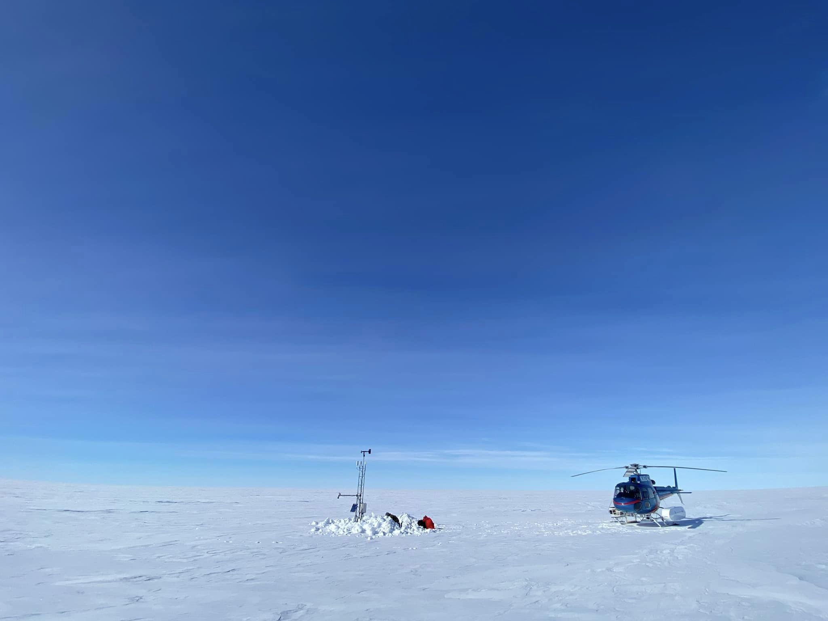






The Future
US Antarctic Automatic Weather Station Network
Dr. Matthew A. Lazzara
and the AWS Team
Antarctic Meteorological Research and Data Center
Department of Physical Sciences, Madison Area Technical College
Space Science and Engineering Center, University of Wisconsin-Madison
Lorne AWS Courtesy of Taylor Norton

Slide 2
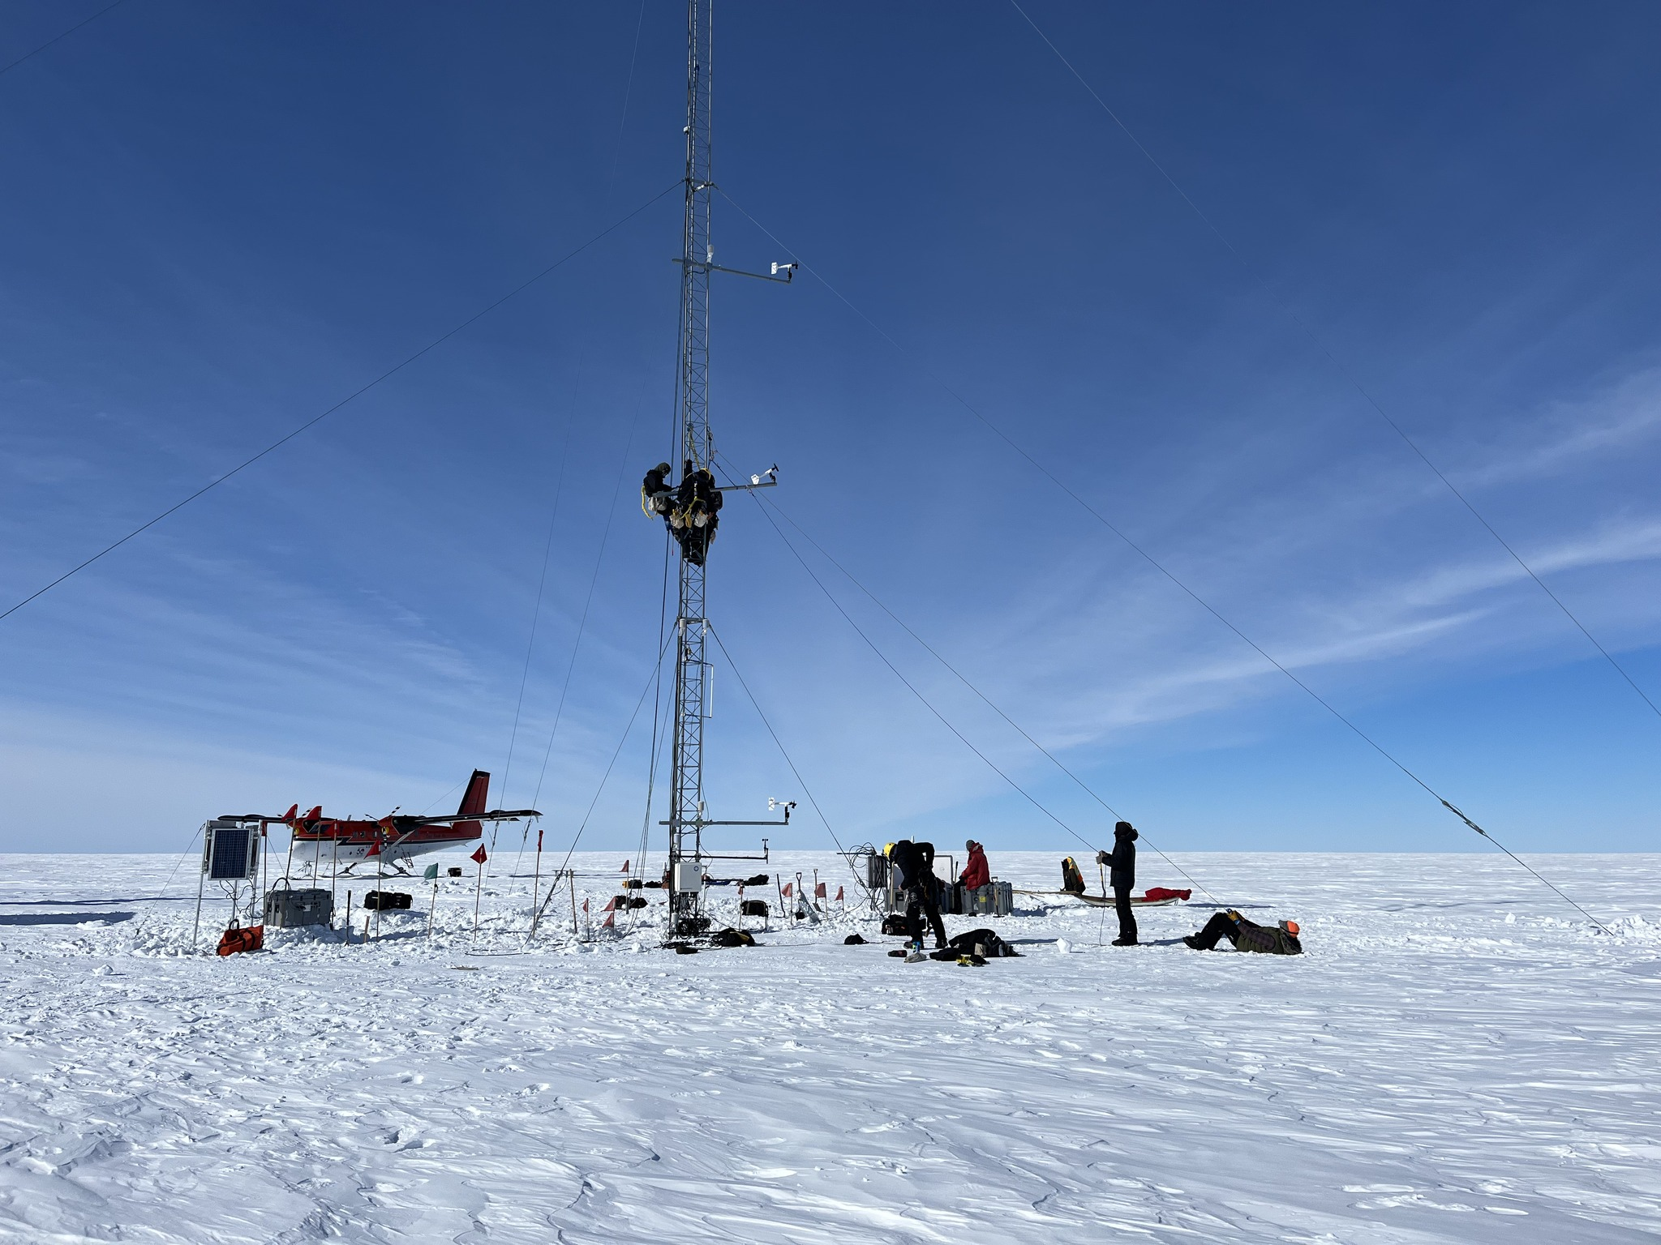
Outline
Field Season 2023-2024
The Future
Network Status
Challenges
Realistic Plans
Retooling the field season
Pending proposal…
Unfinished business
Homework
AWS Data
Questions & Acknowledgements
Photo courtesy of Taylor Norton (Alexander Tall Tower! AWS)

Slide 3
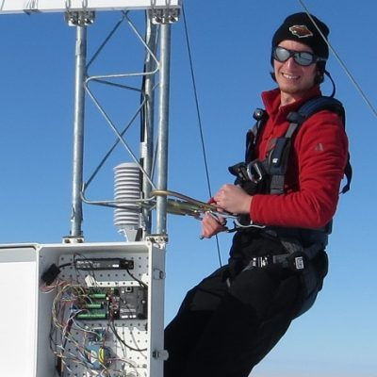
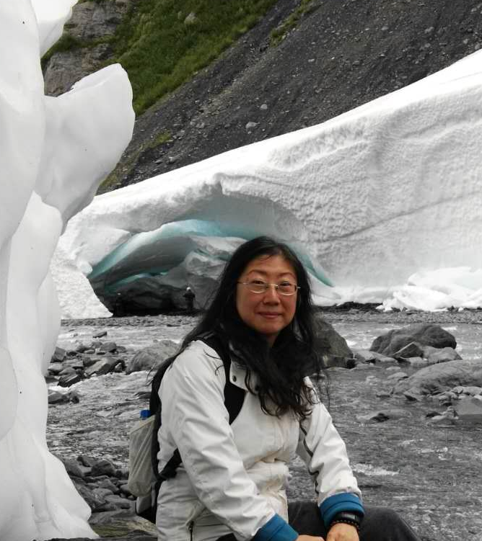
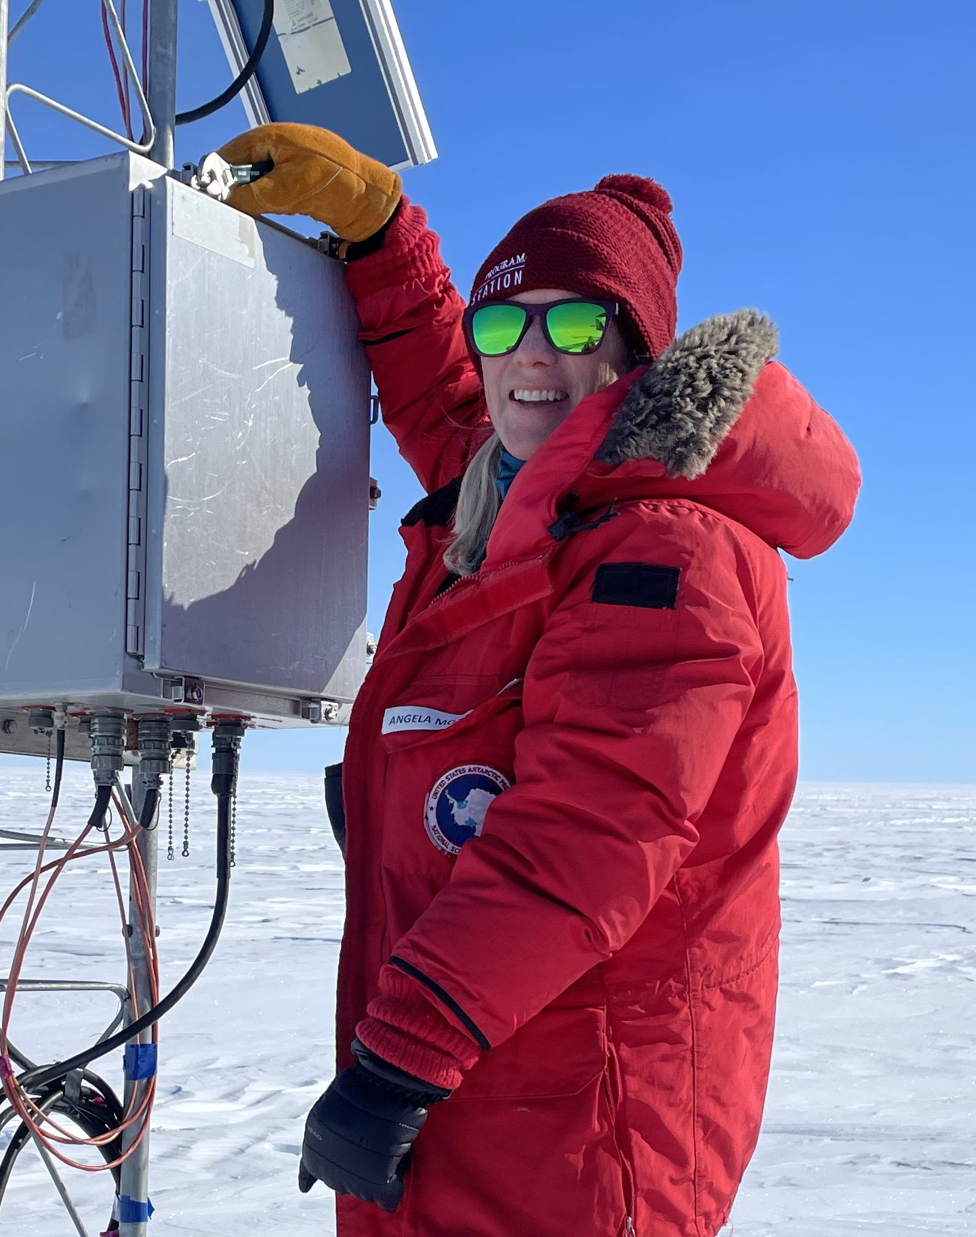
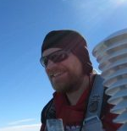
Field Season 2023-2024
UW-Madison
Theme: A limited/targeted field season
Goals: West Antarctic AWS Network servicing – Primary
  McMurdo/Ross Island – Secondary
Dave Mikolajczyk – Primary
  Lee Welhouse - Backup
Wenhua Wu – Primary
  Angie Montgomery – Backup
Collaborators/UW-Madison
NIPR/Japan/UW-Madison
Specific AWS replacement
  Dome Fuji and Relay Station
IPEV/France/UW-Madison
  No work possible
BAS/UK/UW-Madison
  No work planned
Mawson’s Hut/UW-Madison
  Completed

Slide 4
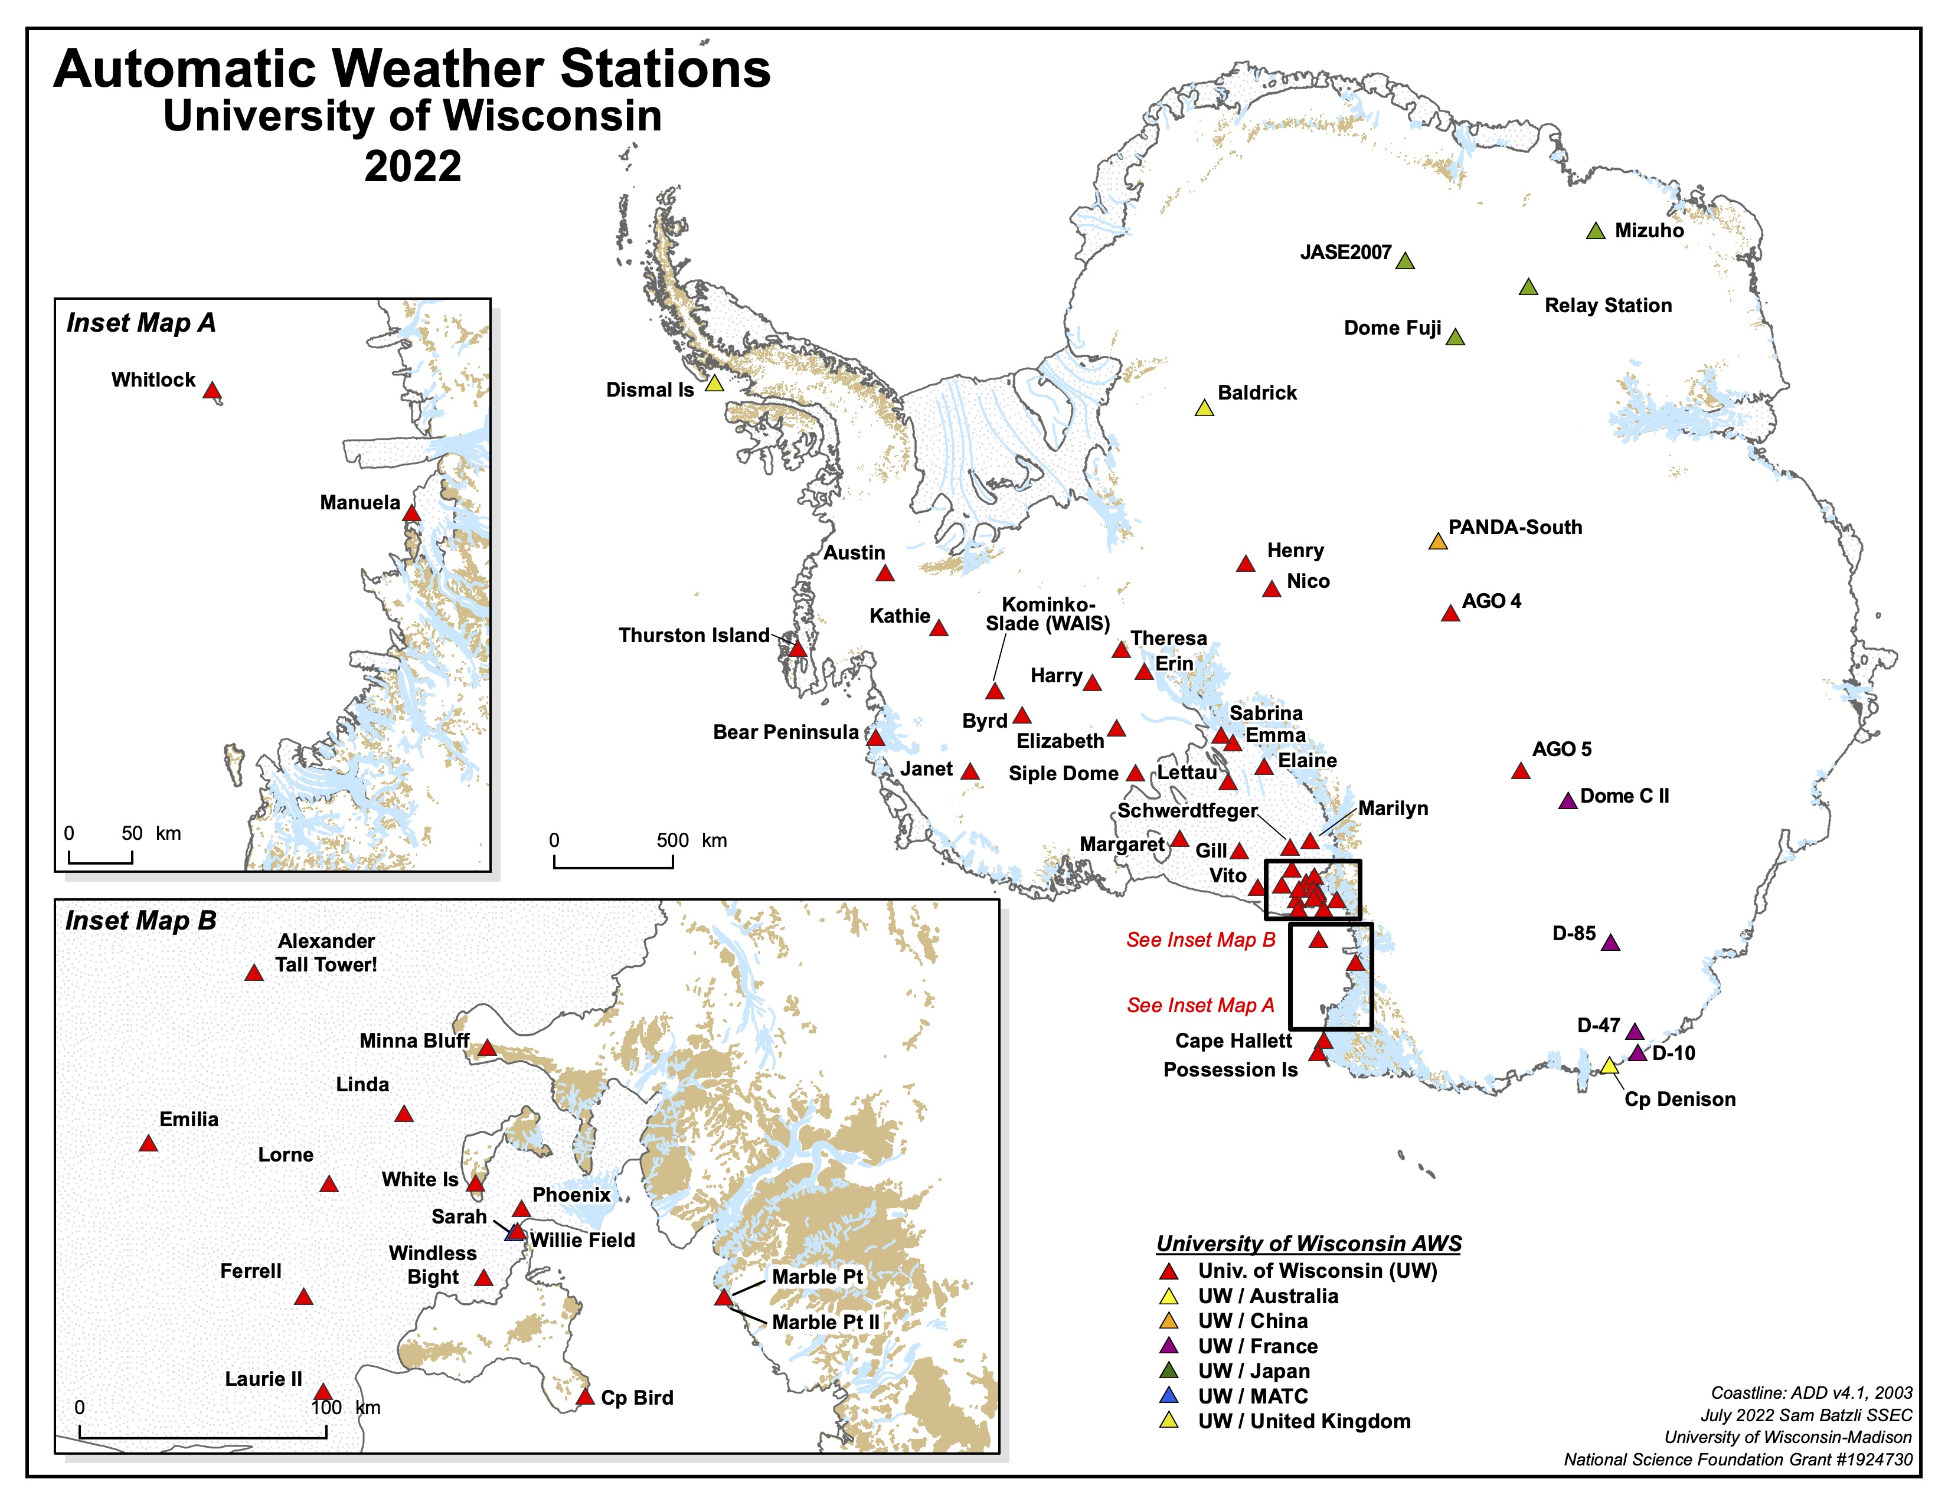

Slide 5
-- Cancelled --

Slide 6
The Future: Network Status
Lost/Buried:
Austin and Kathie
Sensor Repair:
Whitlock, Manuela, Thurston,
Is., Bear Peninsula, Sabrina.
Skomik, Minna Bluff, White Is.
Sarah, Vito, Emilia
Power System Problem:
Theresa, D-85, others
Needs Raising (4+ years):
Byrd, Siple Dome, Gill, AGO-4,
Nico, Henry, Baldrick
Need Replacement:
Dome Fuji, Relay Station,
Mizuho, JASE2007, Dismal Is.,
AGO-5, Cape Hallett & Bird
Remove:
Emma

Slide 7
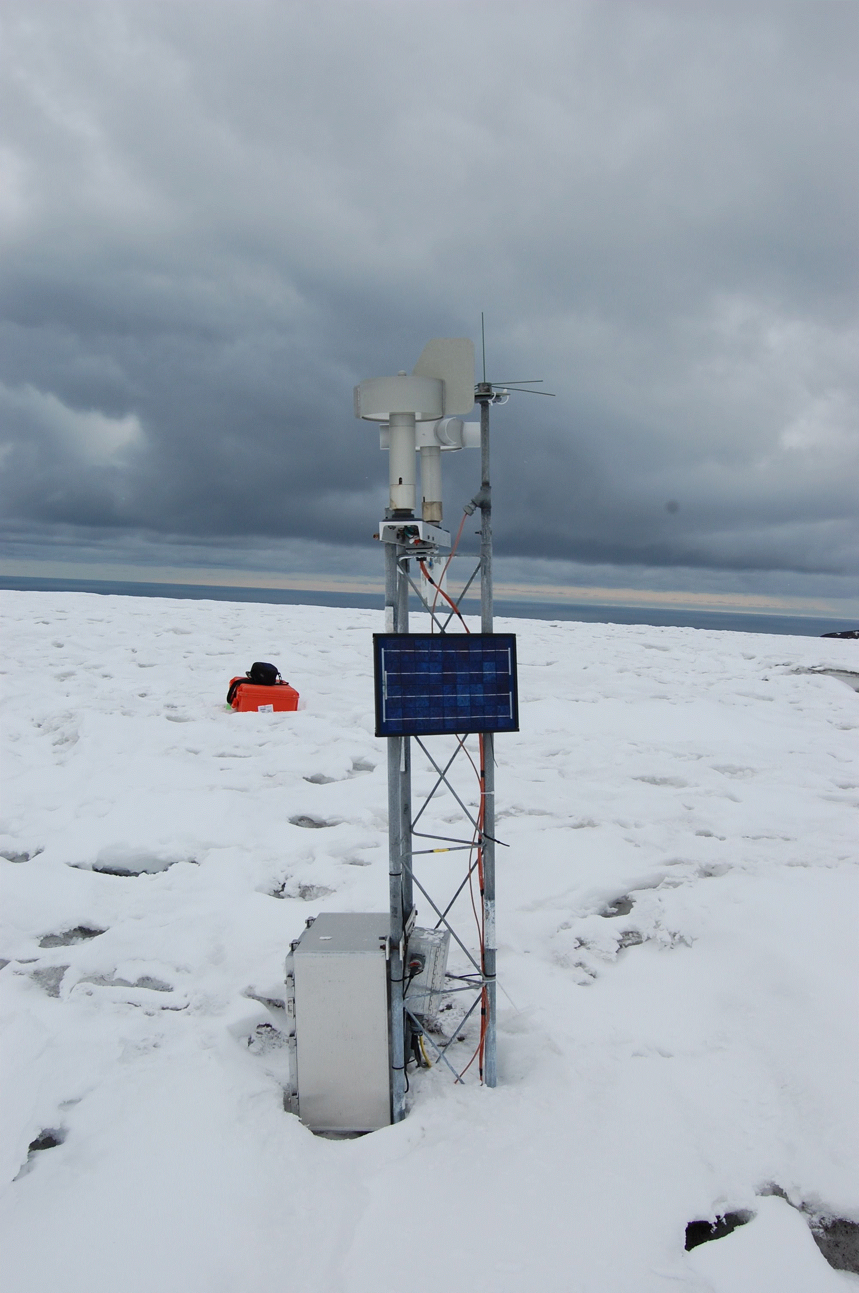
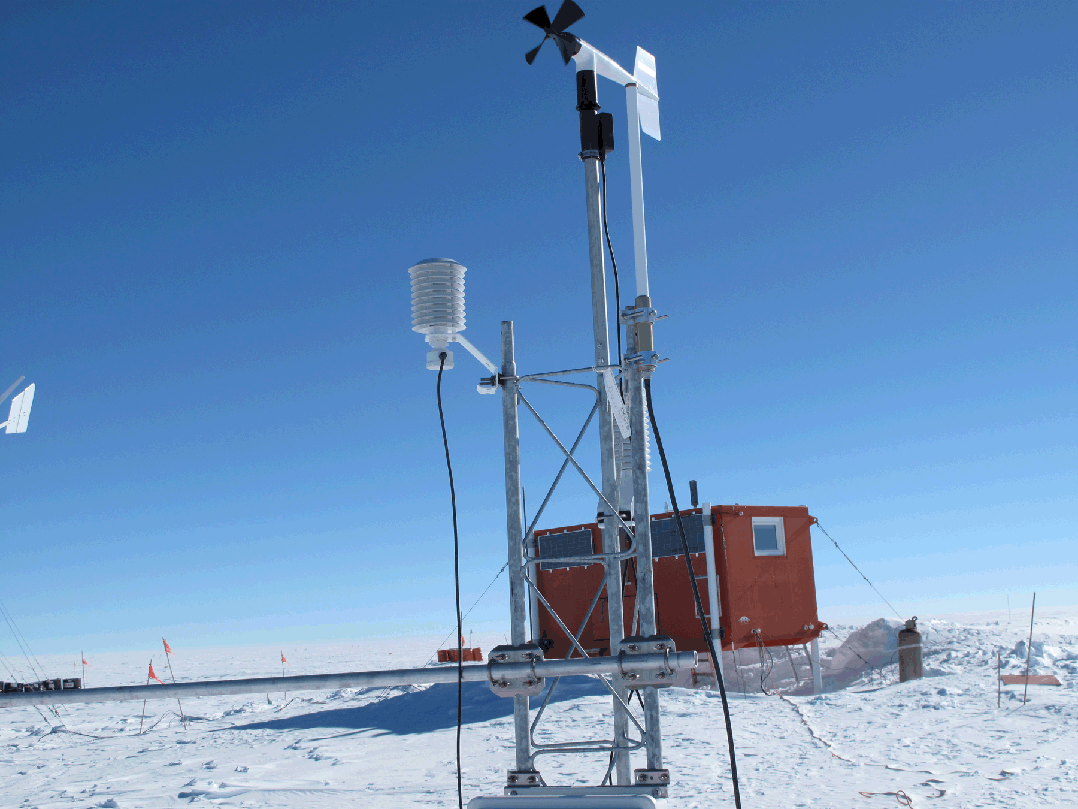
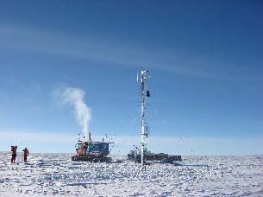
Realistic Plans
– AWS sites with a bleak future
AGO-4
Sites to never be visited again:
  PANDA-South – Operating in summer only
    No plans for visit (China or USA)
  JASE2007- Operating in summer only
    No plans for visit (Japan or Sweden or USA)
  Possession Island – Power system failing
    Being replaced by Cape Hallett
Sites with unclear future:
  AGO-4 - Operational
  AGO-5 – No longer operating/transmitting
    AGO program has come to an end and support and removal of AGO sites is not clear
  Whitlock (Franklin Island) – Wind sensor failure, Servicing needed
    No ship time with helo support available from USA
PANDA-South
Whitlock AWS

Slide 8
Retooling the Field Season
Focus on the Ross Island and Ross Ice Shelf Area
Ross Island Area (via Helo or ground transportation)
  White Island
  Minna Bluff
  Sarah and Willie Field
  Cape Bird (?)
  ?
Ross Ice Shelf Area (via Twin Otter)
  Vito
  Emilia
  Gill
  ?

Slide 9
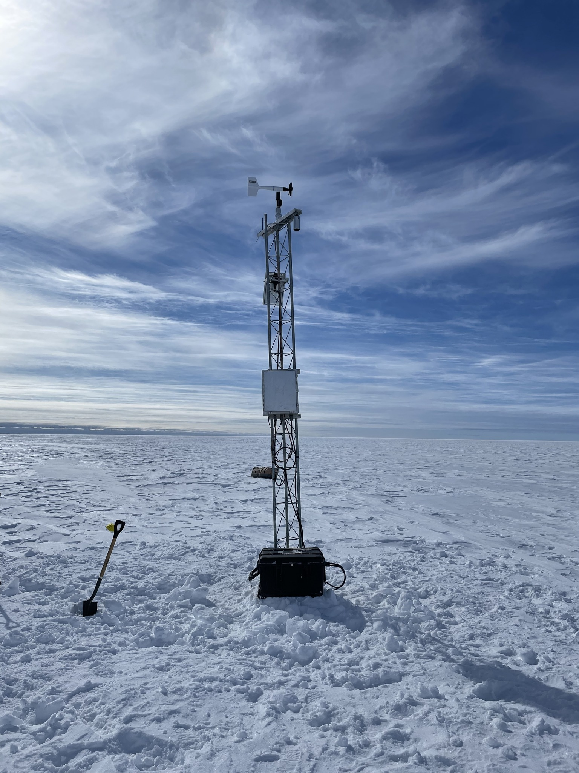
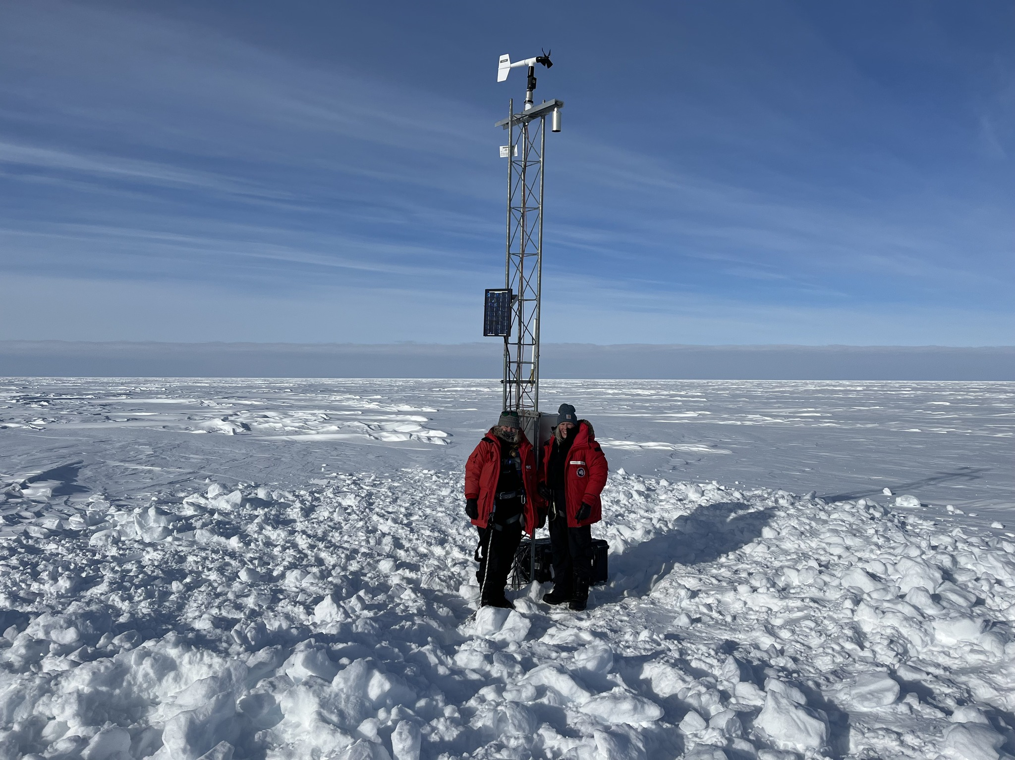
The Future: Challenges
Pandemic impact
  No deployment in 2020-2021
  Limited field work in 2021-2022 and 2022-2023
  No work in West Antarctica for 4 years
    Some sites not visited for up to 7 years!
Dramatic Cost Increases
  2019 → 2023
    Paro. Pressure – $4450 → $5000
    HMP RH – $755 → $920
    CR1000 – $1900 → $2550
    CNR4 Radiation – $7000 → $11000
    Cargo Cost $700 → $1400
  10% to 50% increases!!
Photos courtesy of Taylor Norton

Slide 10


The Future AWS Program
Highlights:
  Network Operations, Maintenance, and Sustainability
  Data Relay and Communications
  AWS Quality Control
  PCWS 3.0
  Database Development
  Advisory Board
  Student Engagement

Slide 11
Unfinished Business
NIWC AWS
Schwerdtfeger AWS
Skomik PCWS
Photo Courtesy of Dave Mikojalczyk
Transition of Marilyn, Schwerdtfeger, and Elaine AWS to NIWC
  NSF requested transition…
Side-by-Side-by-Side testing not completed
  Unable to have all three AWS/PCWS operating
  No hand over planned for 2+ years
After testing – UW continues to QC data, Names remain the same, Tower?

Slide 12
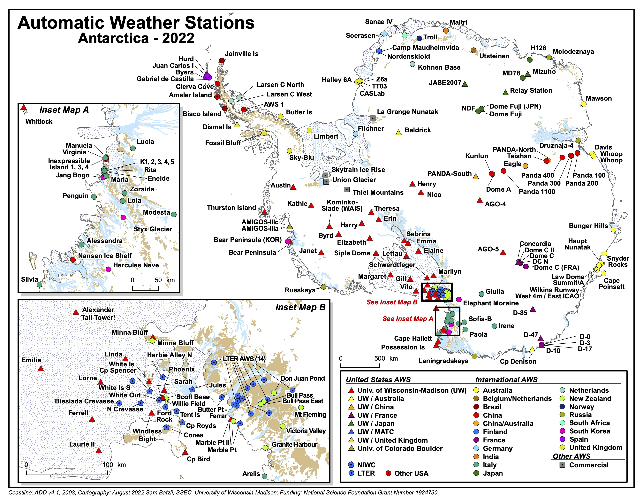
Homework: Please send updates on this map!
Email corrections & updates to mattl@ssec.wisc.edu
Requirements: Name, Latitude, Longitude, Elevation

Slide 13
AWS Data: Where can I get some??
Real-time:
  GTS BUFR (not inside the USA or NOAAport)
    WMO = ISMA01, ISMA02, ISMA03, ISMA46, ISMA47, ISMA48
    WSTN = KWBC
  GTS ‘TAC’ or synoptic messages are degraded or no longer available
  Web:
    https://amrc.ssec.wisc.edu/data/view-data.php?action=list&product=surface
  Meteorological Data Services: - Contact Matthew for details
    McIDAS ADDE
    LDM
    THREDDS (coming soon)
Archive: AMRDC Data Repository
  https://doi.org/10.48567/1hn2-nw60
  https://amrdcdata.ssec.wisc.edu/group/automatic-weather-station-project
  FTP site degrading in 2023….will be sunset in 2024.

Slide 14

Congratulations Lee!
Theodore Chesnik-Welhouse
  Born May 24
  Baby, Mom, & Dad are well

Slide 15
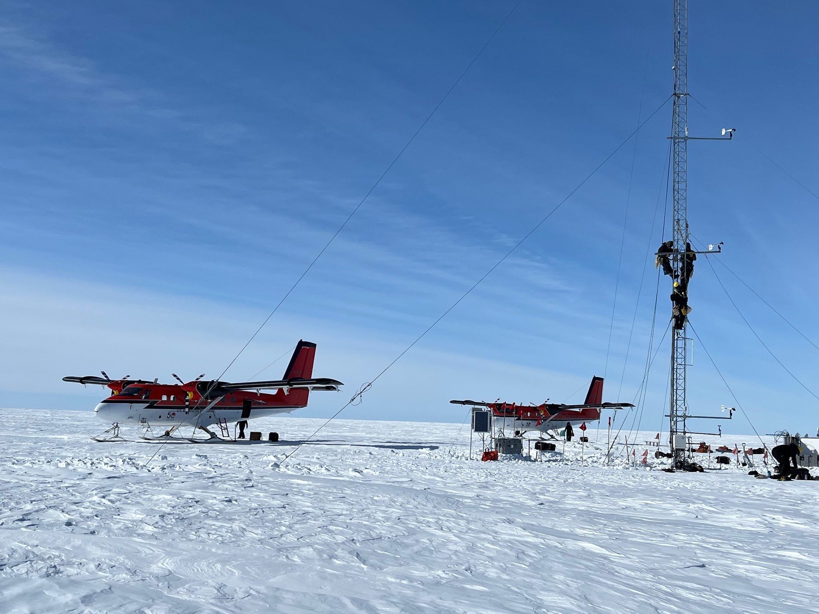

Thank you! Questions?
Acknowledgements: Thanks for the support from the National Science Foundation, Directorate for Geosciences, Office of Polar Programs
NIWC Office of Polar Programs & Antarctic Support Contract
NY 109th ANG, 62nd USAF, Ken Borek Air, & PHI Helos
E-mail: mattl@ssec.wisc.edu mlazzara@madisoncollege.edu
Web: http://amrc.ssec.wisc.edu https://amrdcdata.ssec.wisc.edu
Courtesy of Dave Mikolajczyk

