Slide 1
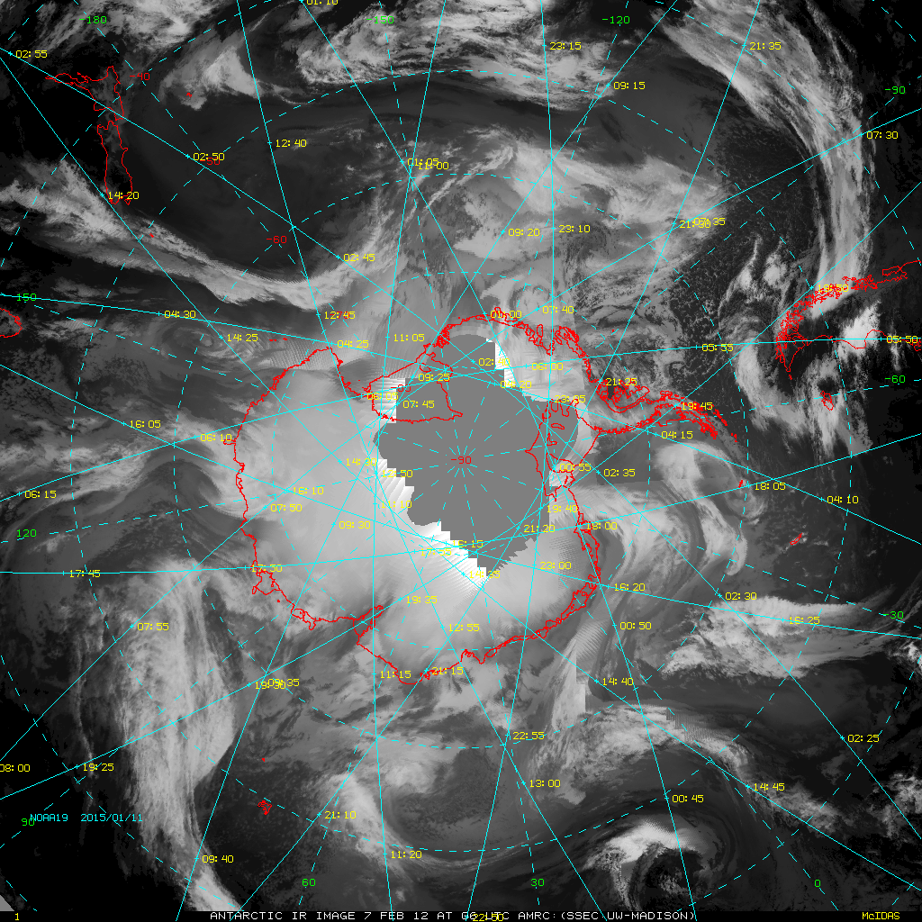
Cloud Mass Meridional Transport Events From the Southern Ocean into Antarctica
Joseph Nettesheim^{1,2}, Matthew A. Lazzara^{1,3}, Linda Keller^{1, 2}, Joey Snarski^{1,*}, Maria Tsukernik^{4,} K. Elena Wilmot ^{1,+}, Jessica Braun¹, and Carol Costanza¹
¹ Antarctic Meteorological Research Center, Space Science and Engineering Center
² Department of Atmospheric and Oceanic Sciences
University of Wisconsin-Madison, Madison, WI, USA
³ Department of Physical Sciences, School of Arts and Sciences, Madison Area Technical College, Madison, WI, USA
⁴ Environmental Change Initiative, Department of Geological Sciences, Brown University, Providence, RI, USA
* Now at Scientific Research Corporation, Charleston, SC
⁺ Now at Vanderbilt University, Nashville, TN
Introduction
Methods
Results
Discussion
Summary

Slide 2
Cloud Mass Meridional Transport Event (CMMT) Motivation and Implementation
Occasional shifts in general flow, as seen from satellite composite imagery
Associated with precipitation, high winds
Identify favorable regions
Climatology Nov 1992 – 2012
IR vs WV
Introduction
Methods
Results
Discussion
Summary

Slide 3
CMMT Definition
Poleward-propagating synoptic-scale cloud mass
Min 48 hr poleward advection
Two events within 12 hrs → assumed same system
Event:
0600 UTC 17 May 2009 – 1500 UTC 21 May 2009
Introduction
Methods
Results
Discussion
Summary
Notes:
***Will I have the ability to click while presenting?
***Reference Staude’s definition
Possible Questions:
Why a two day min?

Slide 4
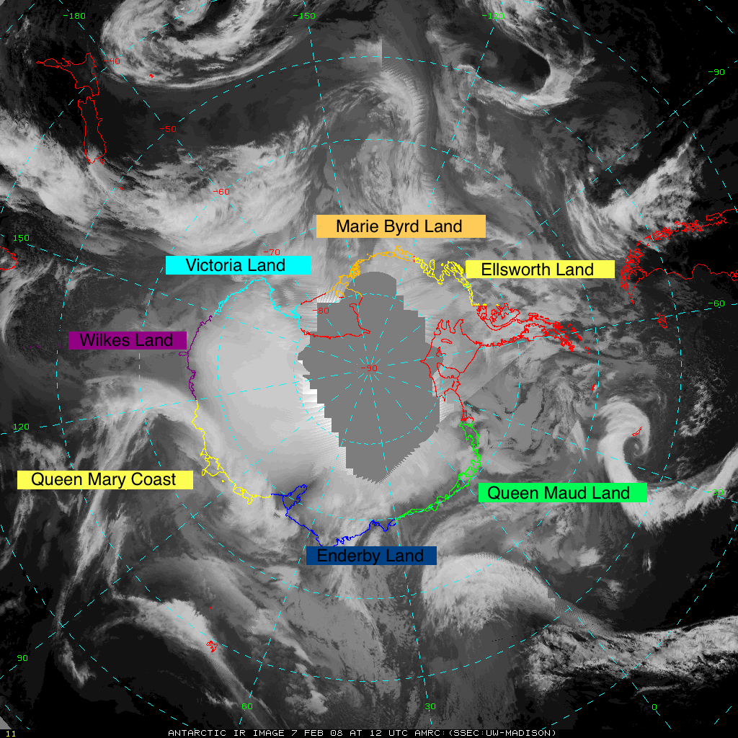
Splitting up the continent CMMT Sectors
Sector | Longitudinal Bounds
Marie Byrd Land (MBL) | 120°W - 150°W
Ellsworth Land (ELS) | 75°W – 120°W
Queen Maud Land (QML) | 30°E – 30°W
Enderby Land (END) | 75°E – 30°E
Queen Mary Coast (QMC) | 120°E – 80°E
Wilkes Land (WLK) | 150°E – 120°E
Victoria Land (VCT) | 150°E – 180°E
Introduction
Methods
Results
Discussion
Summary

Slide 5
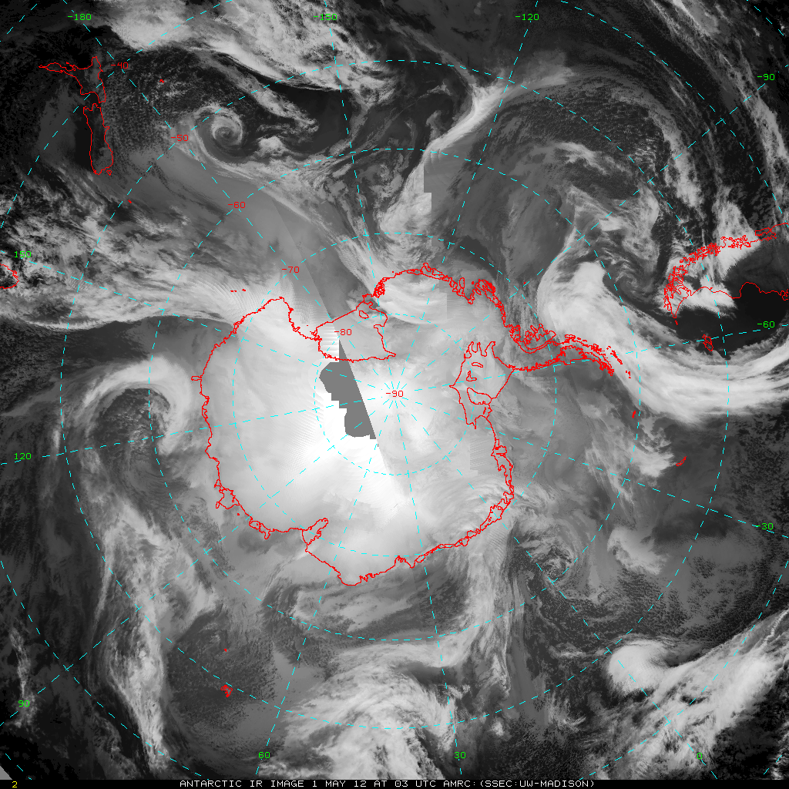
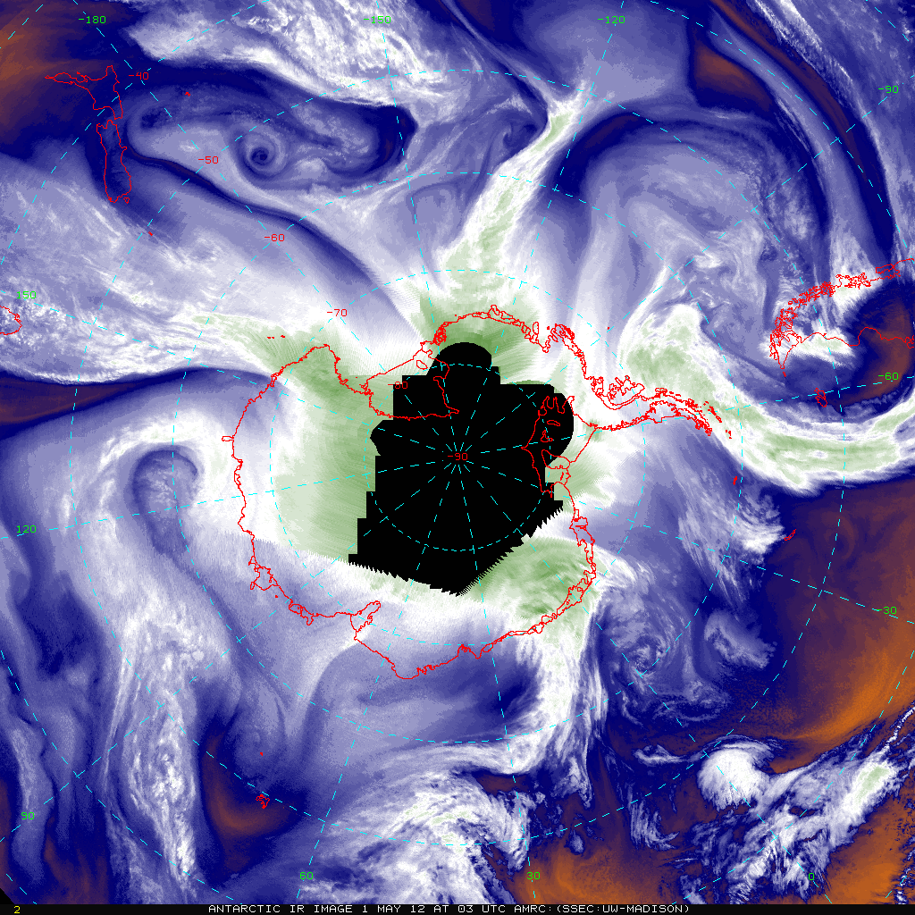
Counting Method Composite Images
Reviewed ‘tapes’ of IR composites
Monthly for 3hrly composites
Load 248 images for 1hrly (~1/3 of a month)
Composites courtesy of AMRC archive
Introduction
Methods
Results
Discussion
Summary
Notes:
Why the missing data around the pole (WV)

Slide 6
Counting Method Addressing Numerous Counters
Multiple different counters compiled the climatology
Introduces potential errors
Test year 2009
IR event # and duration correlations high (.9)
Similar counting methodology
Introduction
Methods
Results
Discussion
Summary

Slide 7
Climatology Antarctic Continent
920+ Events
2650+ Days Affected (over 7 years worth)
Austral Season | Number of Events | Days Affected
Spring (Sept-Nov) | 258 | 729
Summer (Dec-Feb) | 192 | 526
Fall (Mar-May) | 230 | 672
Winter (Jun-Aug) | 244 | 724
53% two-day events
Longest event: 10 days, skirting
Introduction
Methods
Results
Discussion
Summary

Slide 8
Climatology West Antarctica | East Antarctica
2 Sectors (MBL, ELS)
5 Sectors (QML, END, QMC,WLK,VCT)
Regional Area
2,024,257.59 km²
9,617,556.68 km²
3X more active
Nearly 5X larger
Active Season
Austral Winter (Jun-Aug)
~50% Days Affected
Austral Spring (Sept-Nov)
~30% Days Affected
Introduction
Methods
Results
Discussion
Summary

Slide 9
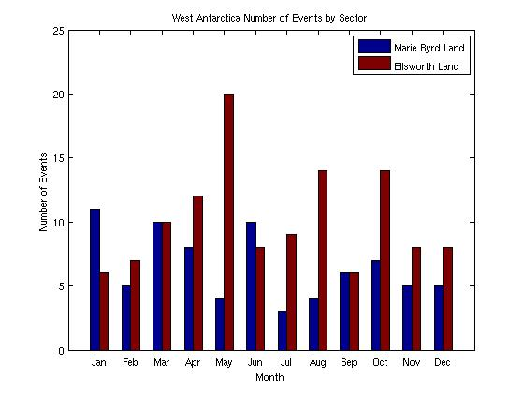
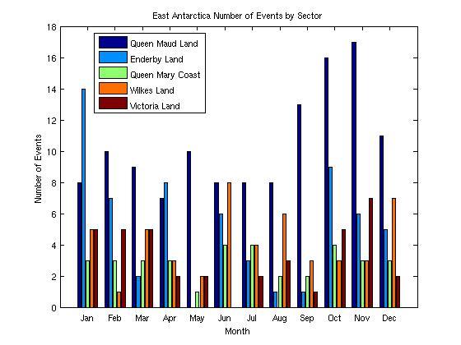
Climatology West Antarctica | East Antarctica
Introduction
Methods
Results
Discussion
Summary

Slide 10
Climatology Notable Sectors
Most Active Sector
Least Active Sector
Marie Byrd Land
(West Ant.; 120°W-150°W; 631,295 km²)
Queen Mary Coast
(East Ant.; 120°E-80°E; 2,449,855 km²)
78 CMMT Events
203 Days Affected
January most active
35 CMMT Events
88 Days Affected
June/July most active
Skirting Events
413 CMMT events
1280 days affected
Austral Winter most active season
45% two-day durations
Longest event: 10-day West Ant. Nov 1997
Introduction
Methods
Results
Discussion
Summary
Notes:
Queen Maud Land: greatest number of events (125)

Slide 11
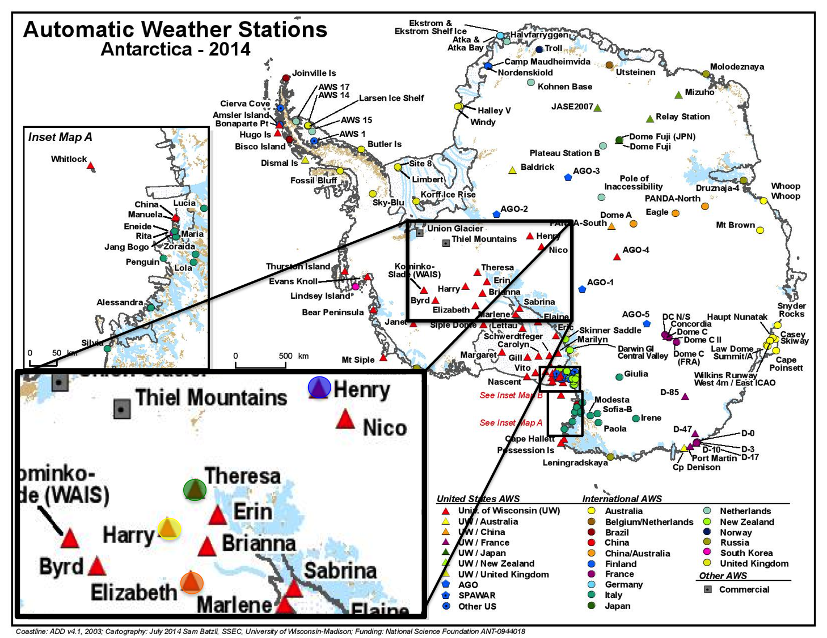
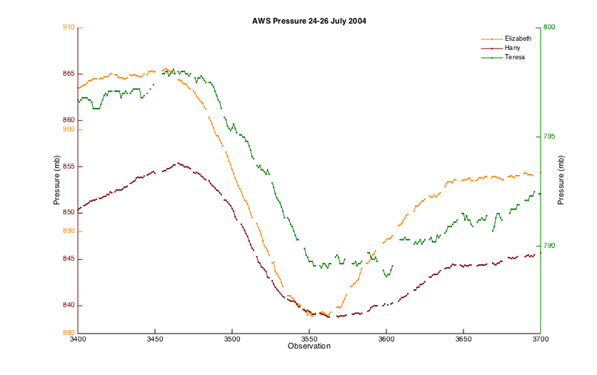
The Importance of CMMT Events Impacts via AWS network
Introduction
Methods
Results
Discussion
Summary

Slide 12
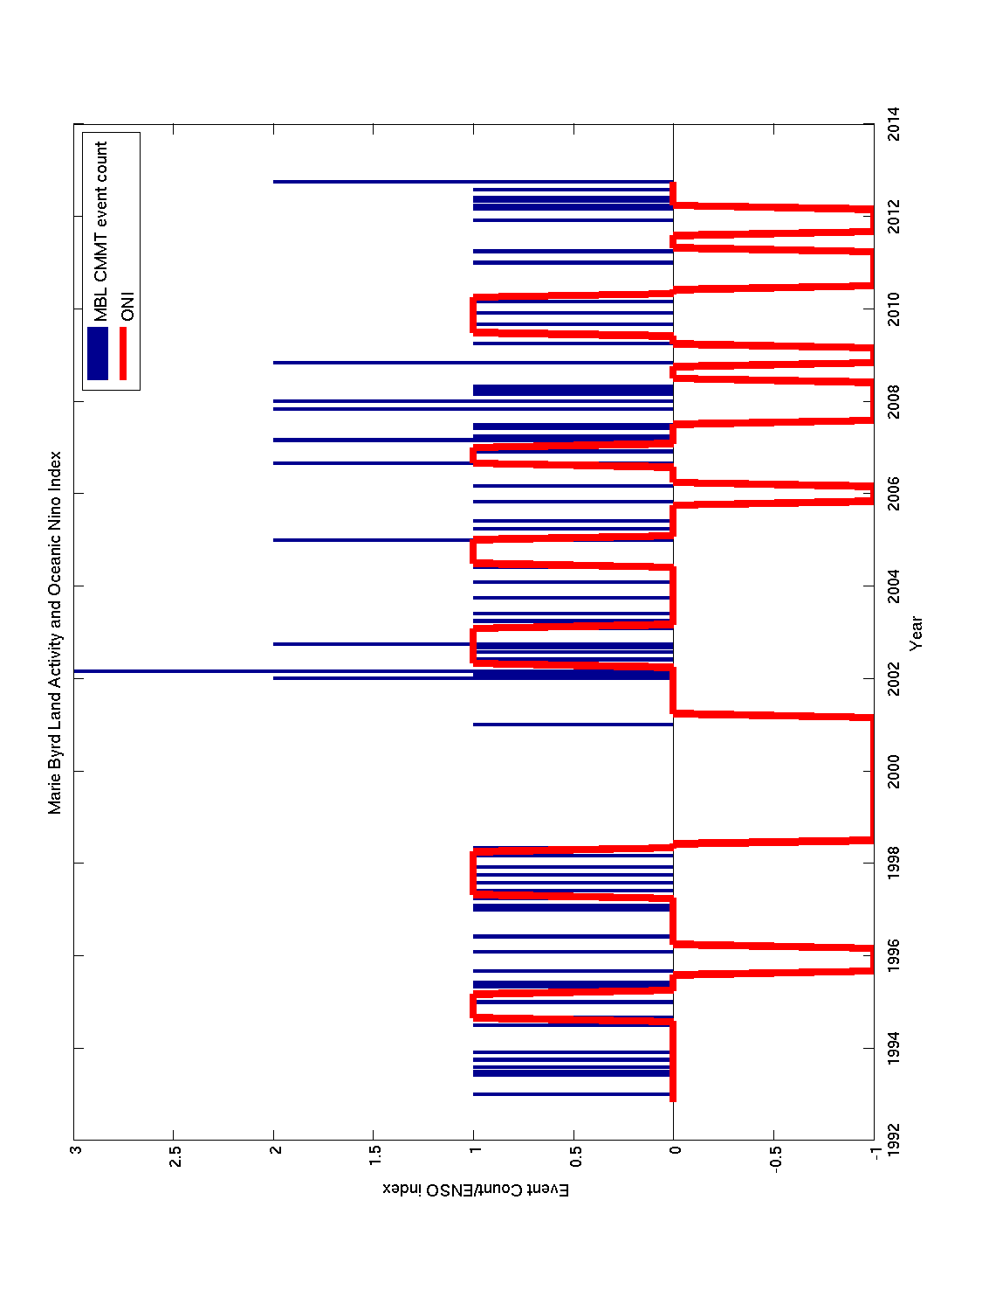
The Importance of CMMT Events Link to Climate Indices?
Correlations between event #/days affected and 4 climate indices:
SOI, SAM, MEI and EMI
Generally little/no correlation. Highest positive correlation: .12 Wilkes Land and EMI. Highest negative correlation: -.13 Victoria Land and SAM
Introduction
Methods
Results
Discussion
Summary
Notes:
Oceanic Nino index (NOAA) (green)
Hiatus in MBL CMMT activity lines up with the strong 1999-2000 La Nina. Similar hiatus 2010-2011 la nina

Slide 13
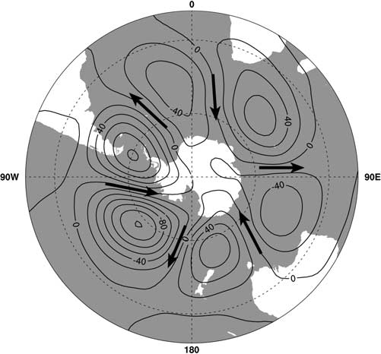
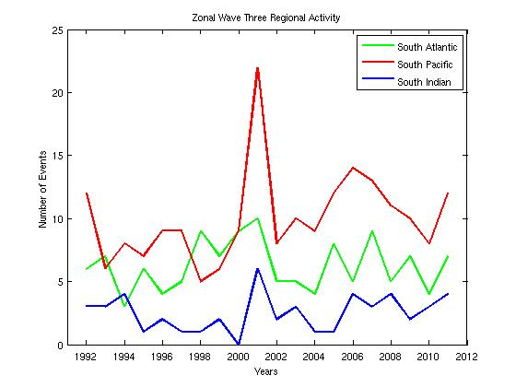
The Importance of CMMT Events Zonal Wave Three
Re-groups sectors to correspond with northerly flow
S. Pacific Ocean: MBL, ELS
S. Atlantic Ocean: QML
S. Indian Ocean: WLK
Summed up activity in 1yr increments
Generally no correlation
2000-2005 exception
Raphael, 2007: The influence of atmospheric zonal wave three on Antarctic sea ice variability J. Geophys. Res., 112, D12112.
Introduction
Methods
Results
Discussion
Summary
Notes:
ZW3 is the major asymmetric part of the large scale atmospheric circulation associated with the meridional flow in the extratropical Southern Hemisphere.
Top left figure is 500hPa geopotential height pattern associated with a strong Zonal Wave three. Regions of preferred northerly and southerly flow.
ZW3 influence greatest in austral fall and winter

Slide 14
Major Findings
West Antarctica favored
3x more active than East Antarctica
Active during winter
Little correlation between CMMT and ENSO
La Nina/MBL hiatus
Possible connection to ZW3
Future Work
Understand impact of CMMT events on:
Sea Ice Extent
Precipitation
Condition 1/2 weather
Automatically track CMMT events
Extend climatology
Introduction
Methods
Results
Discussion
Summary

Slide 15
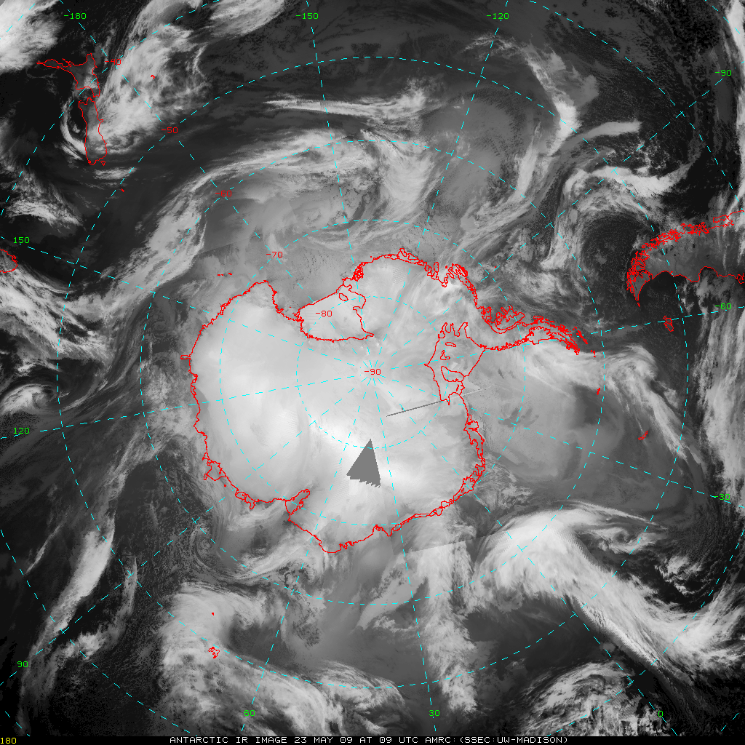
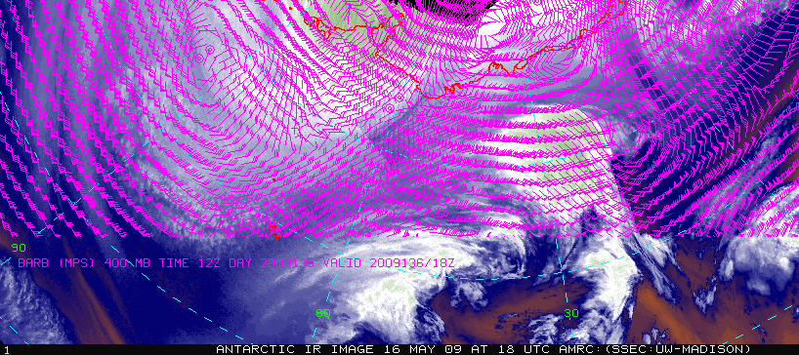
Thank you!
joseph.nettesheim@ssec.wisc.edu
http://amrc.ssec.wisc.edu/
amrc@ssec.wisc.edu
This effort is funded by National Science Foundation Division of Polar Programs Grant #’s ANT-1141908, ANT-1244924 and NSF-1246178
Introduction
Methods
Results
Discussion
Summary

Slide 16
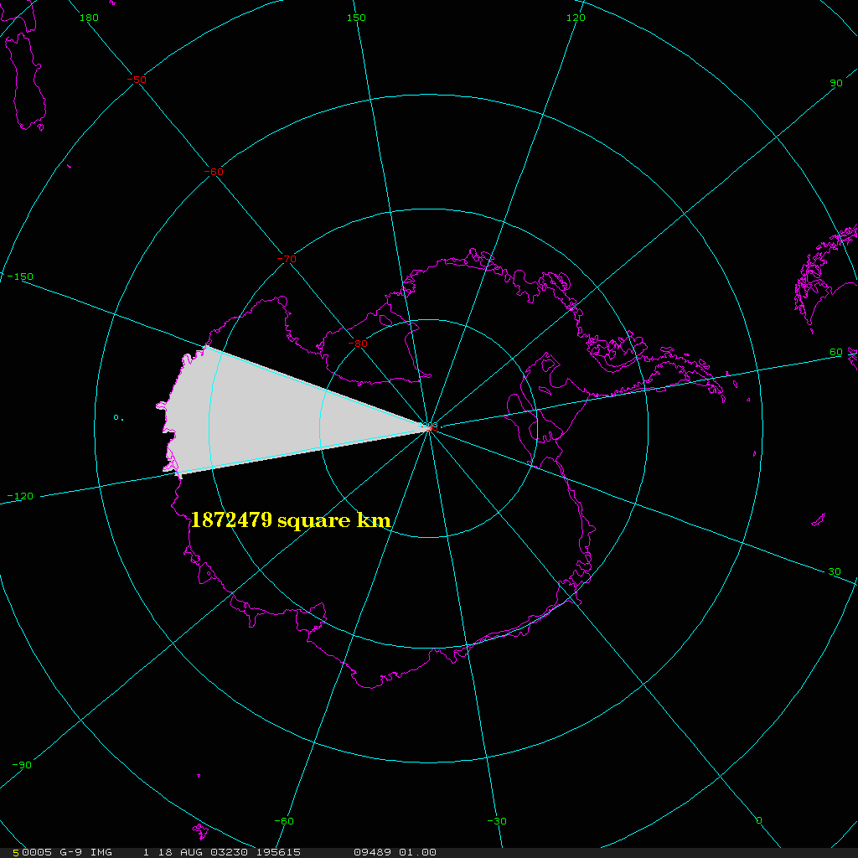
EXTRA: Calculating sector area
Where
R: Radius of Earth
ϕ_{1,2}: latitudinal bounds
λ_{1,2}: longitudinal bounds

Slide 17
EXTRA: Climate Indices
Southern Oscillation Index (SOI)
normalized mean sea level pressure anomaly difference between Tahiti, French Polynesia and Darwin, Australia (Troup, 1965; Parker, 1983)
Courtesy of the Australian Bureau of Meteorology
Southern Annular Mode (SAM)
normalized monthly zonal mean sea level pressure difference between 40ºS and 65ºS
courtesy of the British Antarctic Survey
Multivariate ENSO Index (MEI)
uses six variables observed over the tropical Pacific in order to monitor ENSO
Wolter and Timlin (2011) have discussed the methods behind the calculation in great detail
Courtesy of the NOAA Earth System Research Laboratory

Slide 18
EXTRA: Climate Indices
El Niño Modoki Index (EMI)
differs from a conventional El Niño in that the maximum sea surface temperature anomalies are located in the tropical central Pacific, as opposed to the tropical eastern Pacific for the canonical El Niño
courtesy of the Japan Agency for Marine-Earth Science and Technology
Oceanic Niño Index (ONI)
takes into account the warming trend in the Niñ0-3.4 region since 1950 that results in an inaccurate reflection of interannual ENSO variability. The ONI is calculated using the Niño-3.4 Index but based on centered thirty-year base periods updated every five years.
courtesy of the Climate Prediction Center

