Slide 1


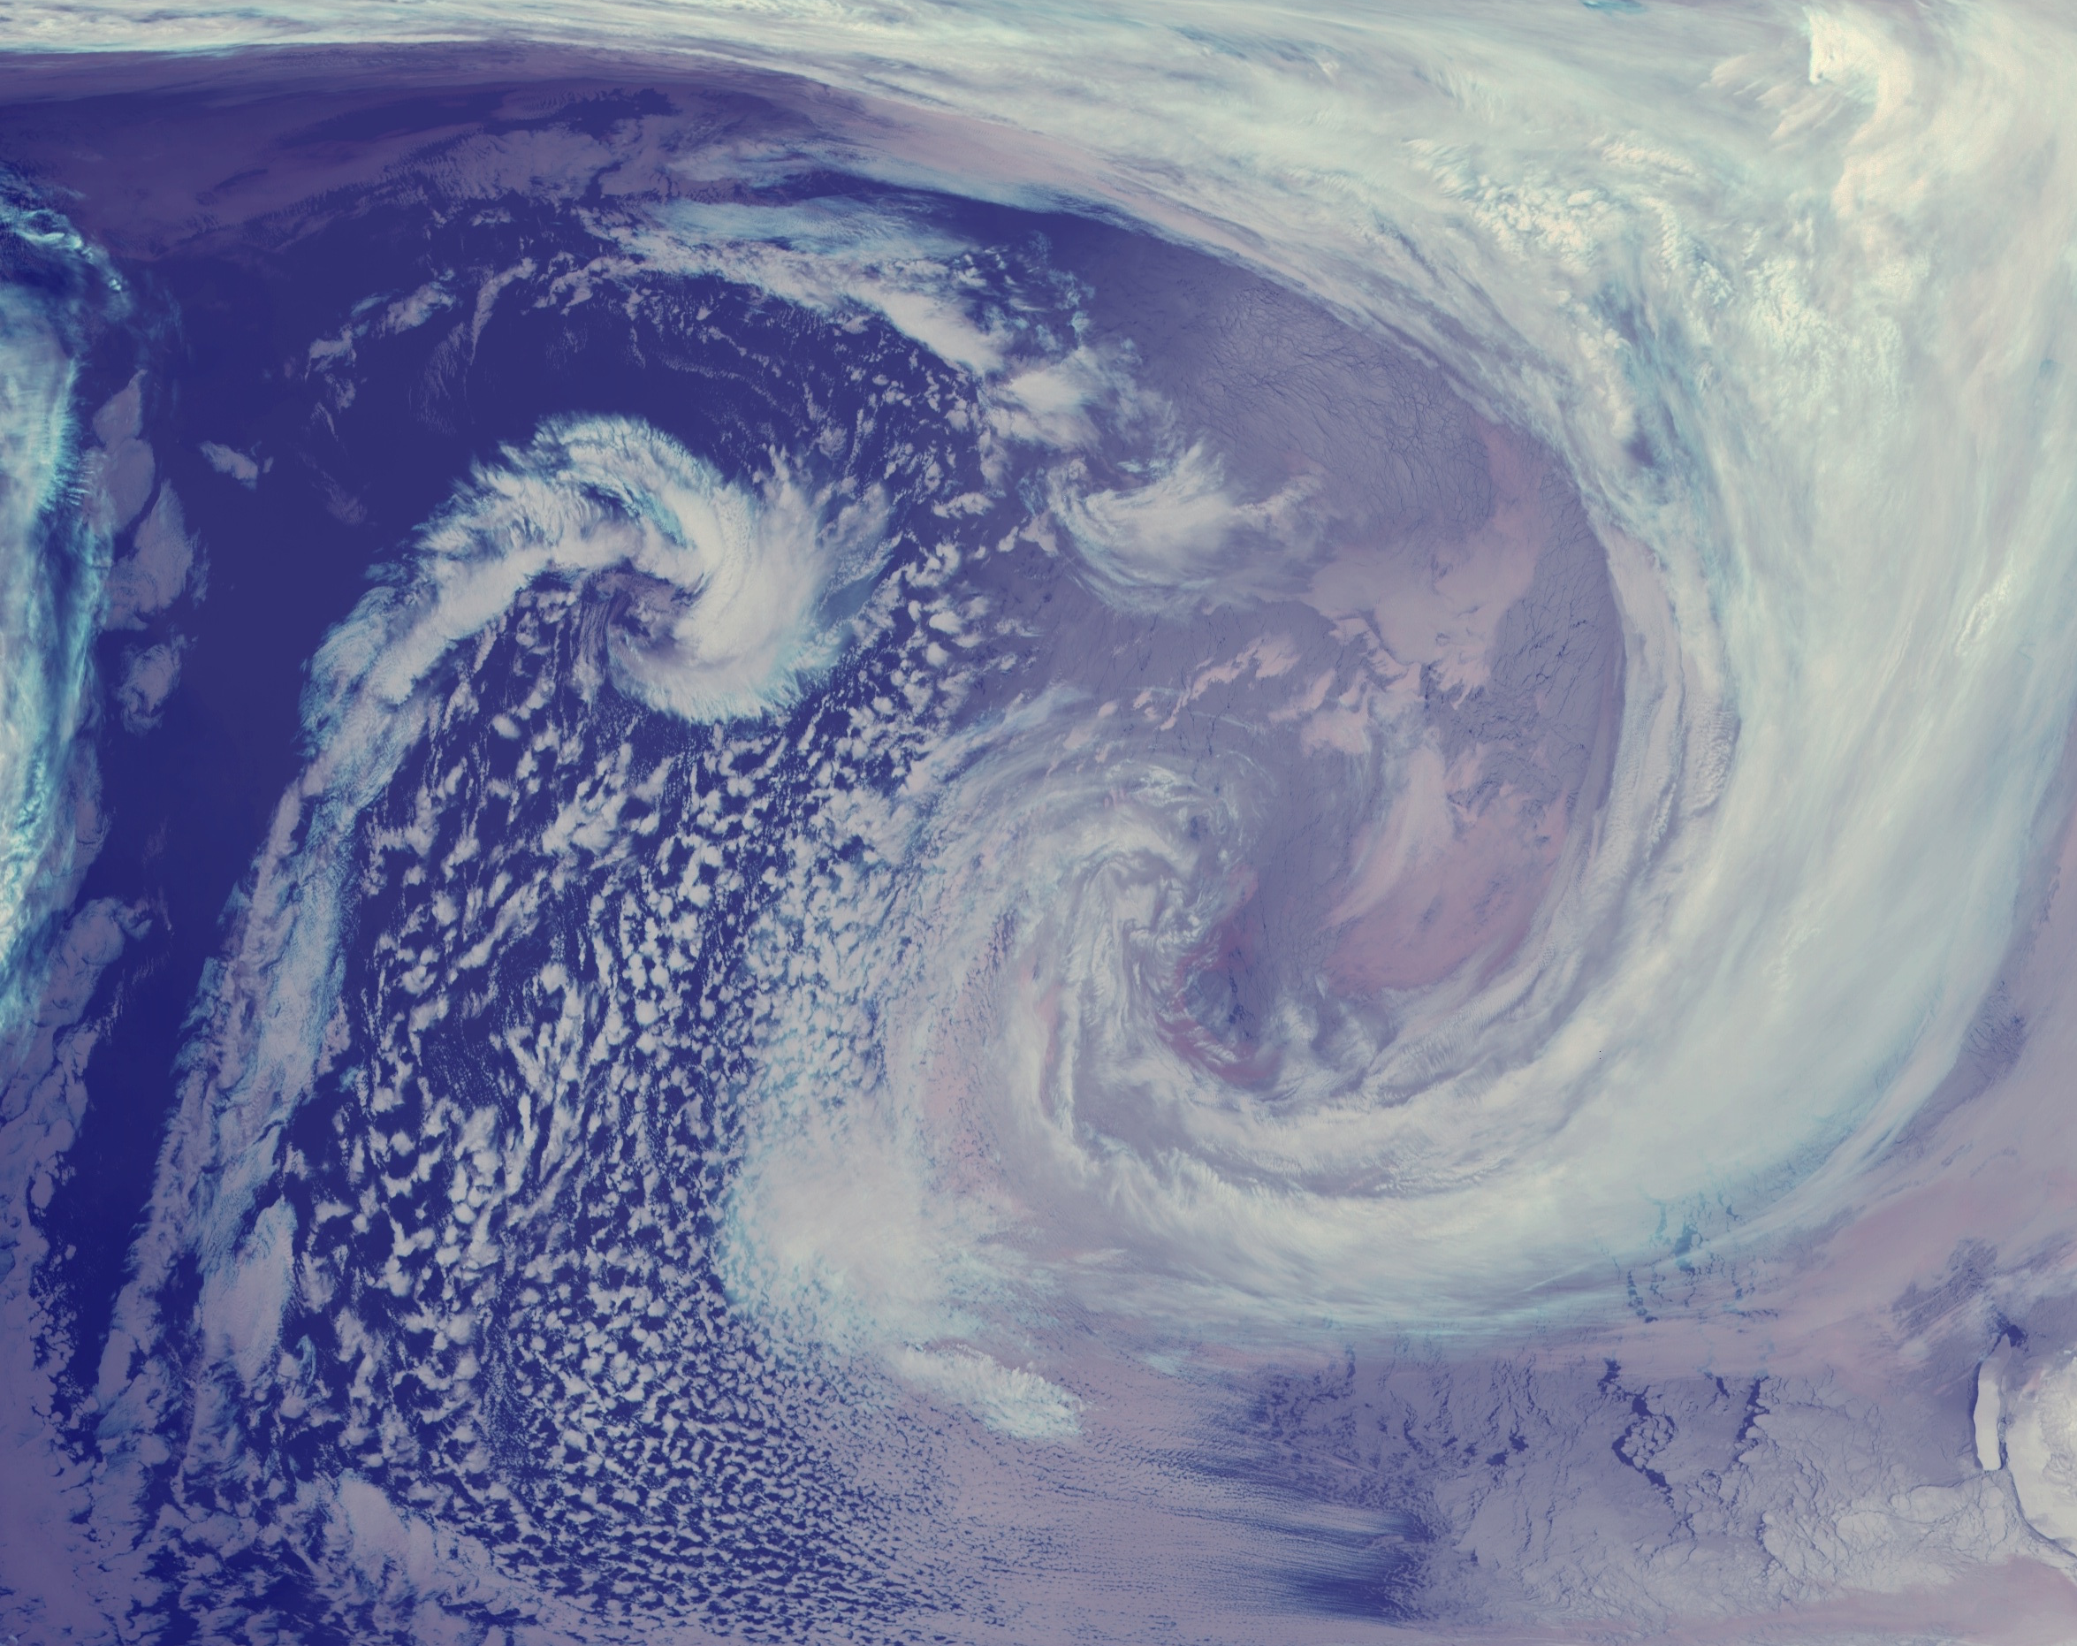



Antarctic Meteorological Research & Data Center
National Science Foundation, Geoscience Directorate, Office of Polar Programs
Dr. Matthew A. Lazzara
Department of Physical Sciences
School of Arts and Sciences
Madison Area Technical College

Slide 2
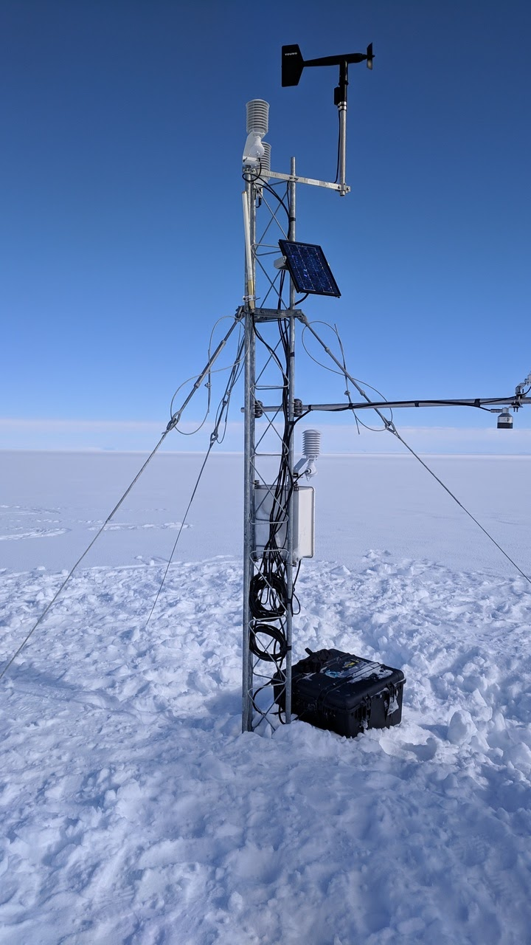
Outline
History of the AMRDC
Major Goals
Major Tasks
Computing
Personnel
Timelines
Marilyn AWS 2019
Thank you to my Co-Authors/Co-Investigators/Project Participants!
David Mikolajczyk, Lee Welhouse, Jean Phillips, Jerry Rodaidek
Jeff Havens, Taylor Norton, and Owen Graham.

Slide 3
History

Slide 4
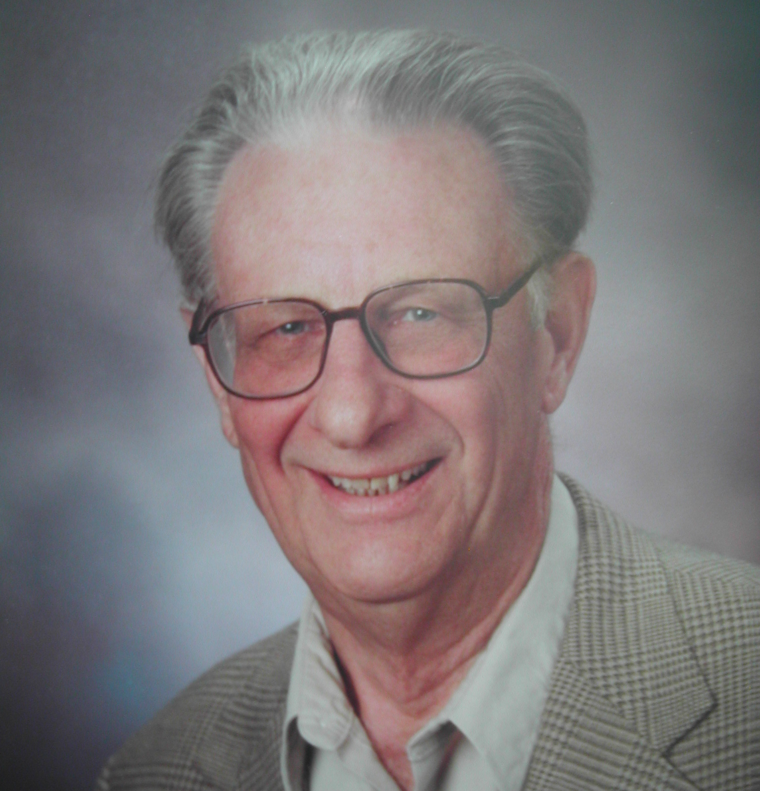
The Spirit of the AMRDC
Professor Charles R. Stearns:
Associated with the UW-Madison for 67 years!
28 years devoted to the Antarctic Automatic Weather Station program as Principal Investigator
18 Years Principal Investigator of the AMRC!
Fostered collaboration and cooperation, nationally and internationally
Data sharing – ahead of his time
Aimed for research, operational and educational applications
Chuck first showed the satellite loop of weather systems spiraling into the Antarctic continent. That was a real eye opener and gave many of us our first glimpse of what the storm systems really looked like around Antarctica. - Dr. Julie Palais, retired NSF/OPP
Chuck was an icon of Antarctic science. - Prof. Susan Solomon, MIT, formerly at NOAA/IPCC
The Antarctic Meteorology Research Center will always be a testament to Dr. Stearns passion for the weather on that continent. – Bruce Sinkula, Weather Central
The hallmark of this work and everything else he did was his unselfishness and willingness to help others. Prof. Bob Ragotzkie, emeritus UW-Madison

Slide 5
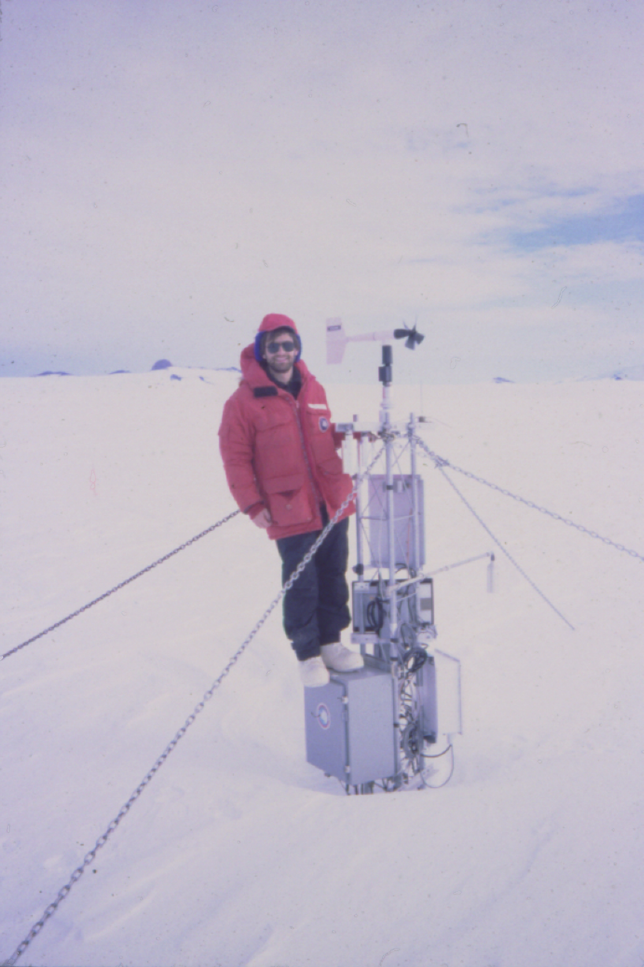
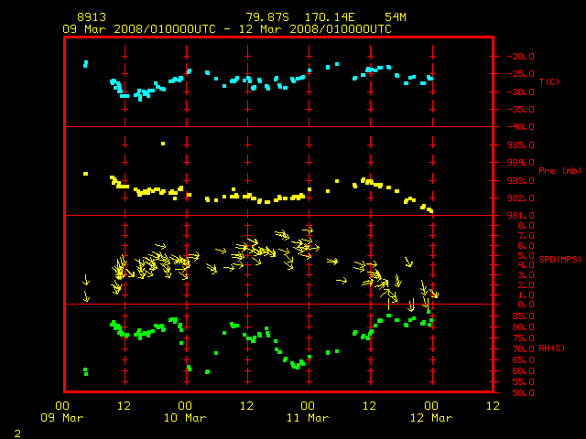
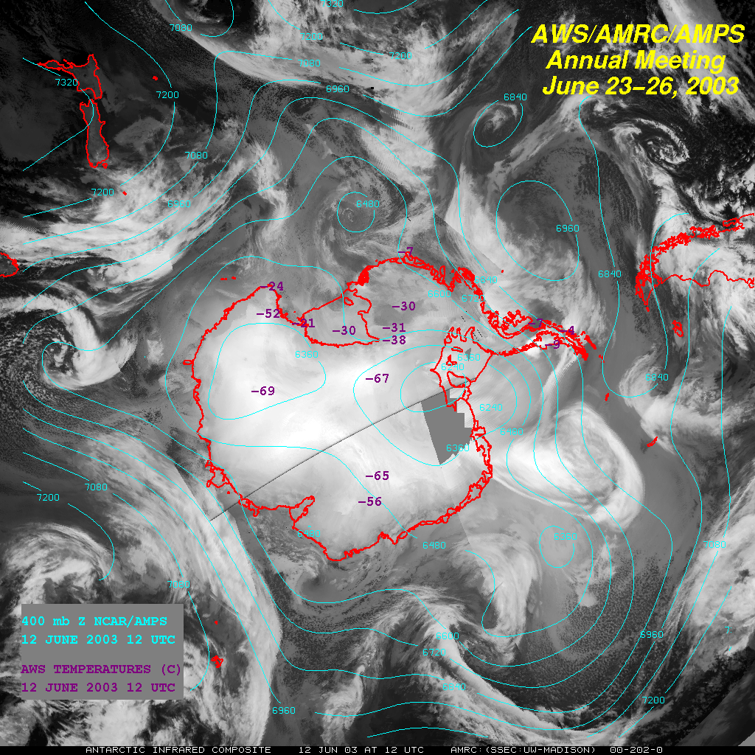
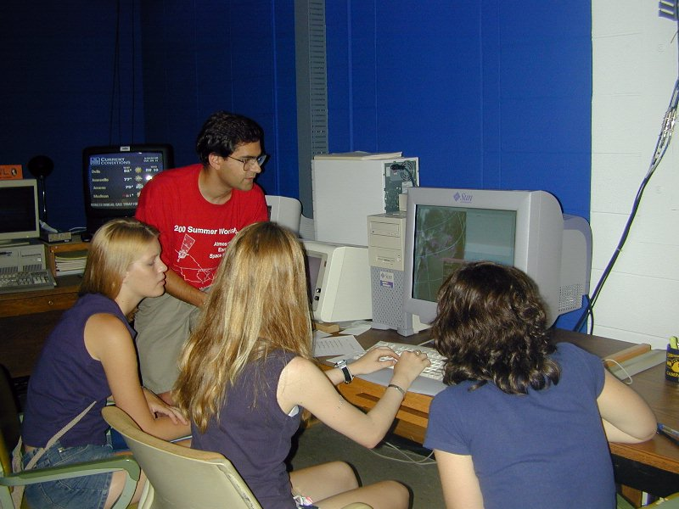
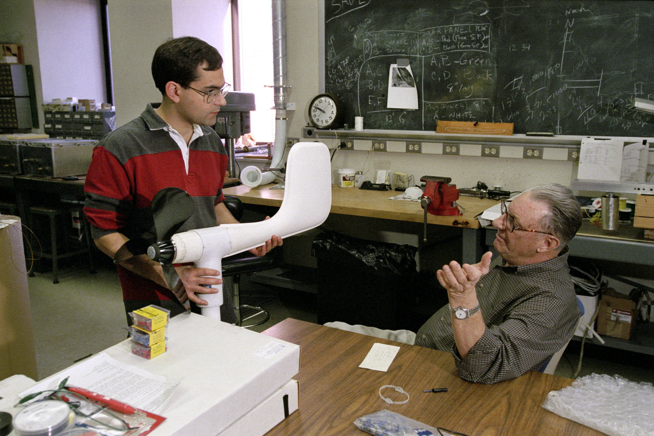
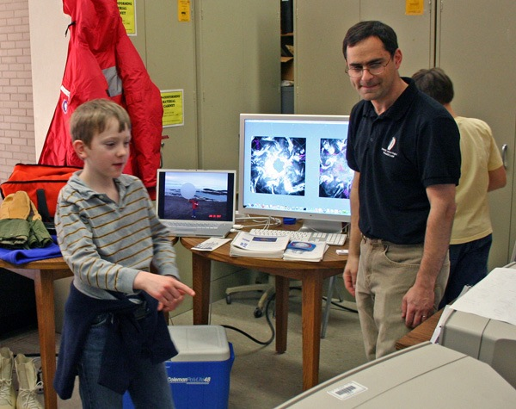
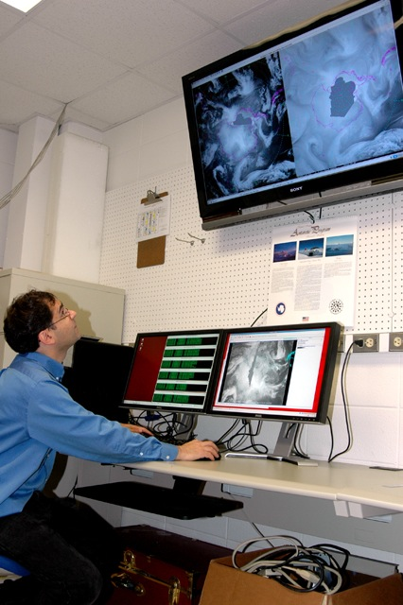
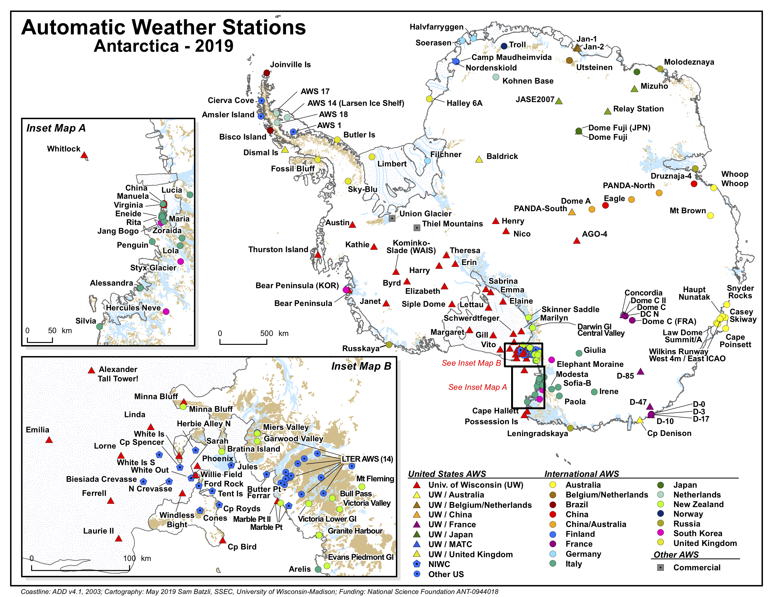
The Antarctic Meteorological Research Center (AMRC) aka Chuck’s Antarctic Meteorological Chop Shop and Data Emporium…
Weather Stations
Satellites
Service
Teaching
Research
Outreach

Slide 6
Review of the USAP Meteorological Enterprise

Slide 7
Major Goals

Slide 8
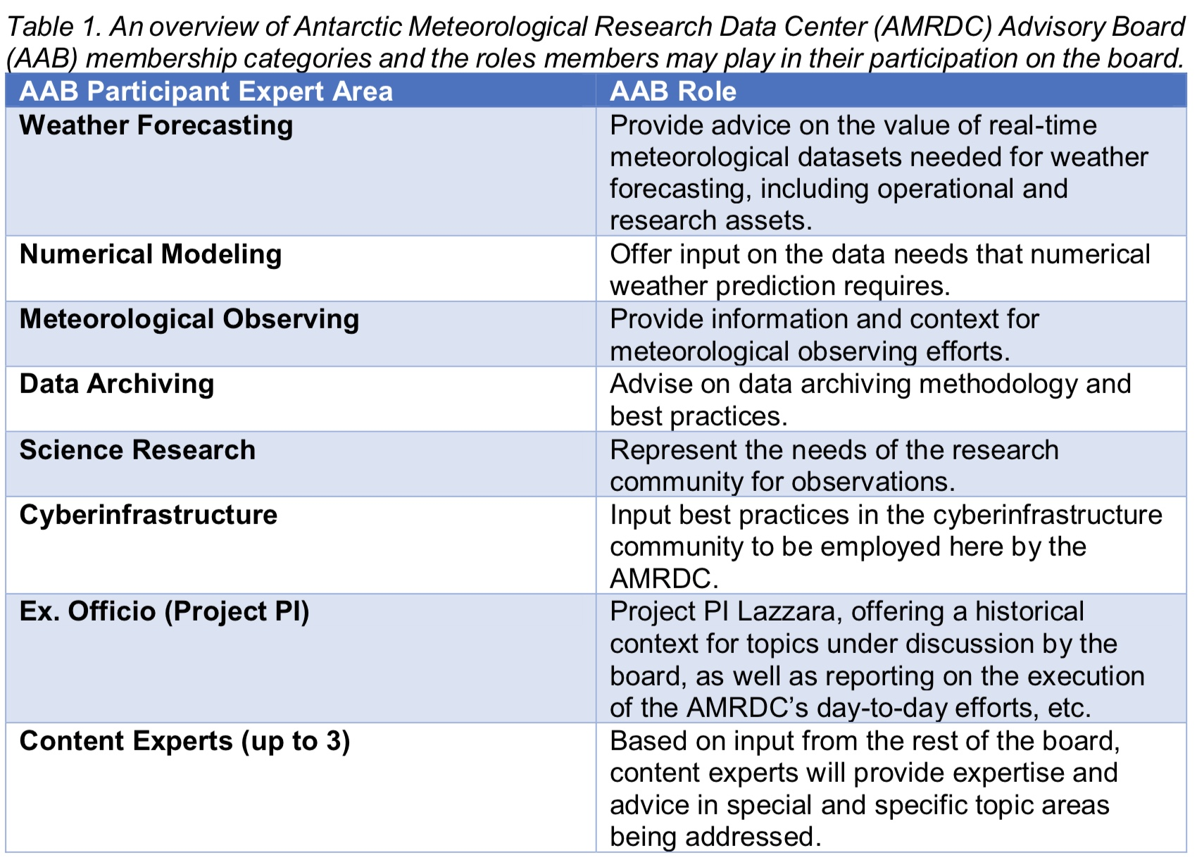
Goals
  Establishing the Antarctic Meteorological Research and Data Center (AMRDC)
  Establishing the AMRDC Advisory Board (AAB)
  Involving students in Antarctic projects and meteorology

Slide 9
Major Tasks

Slide 10
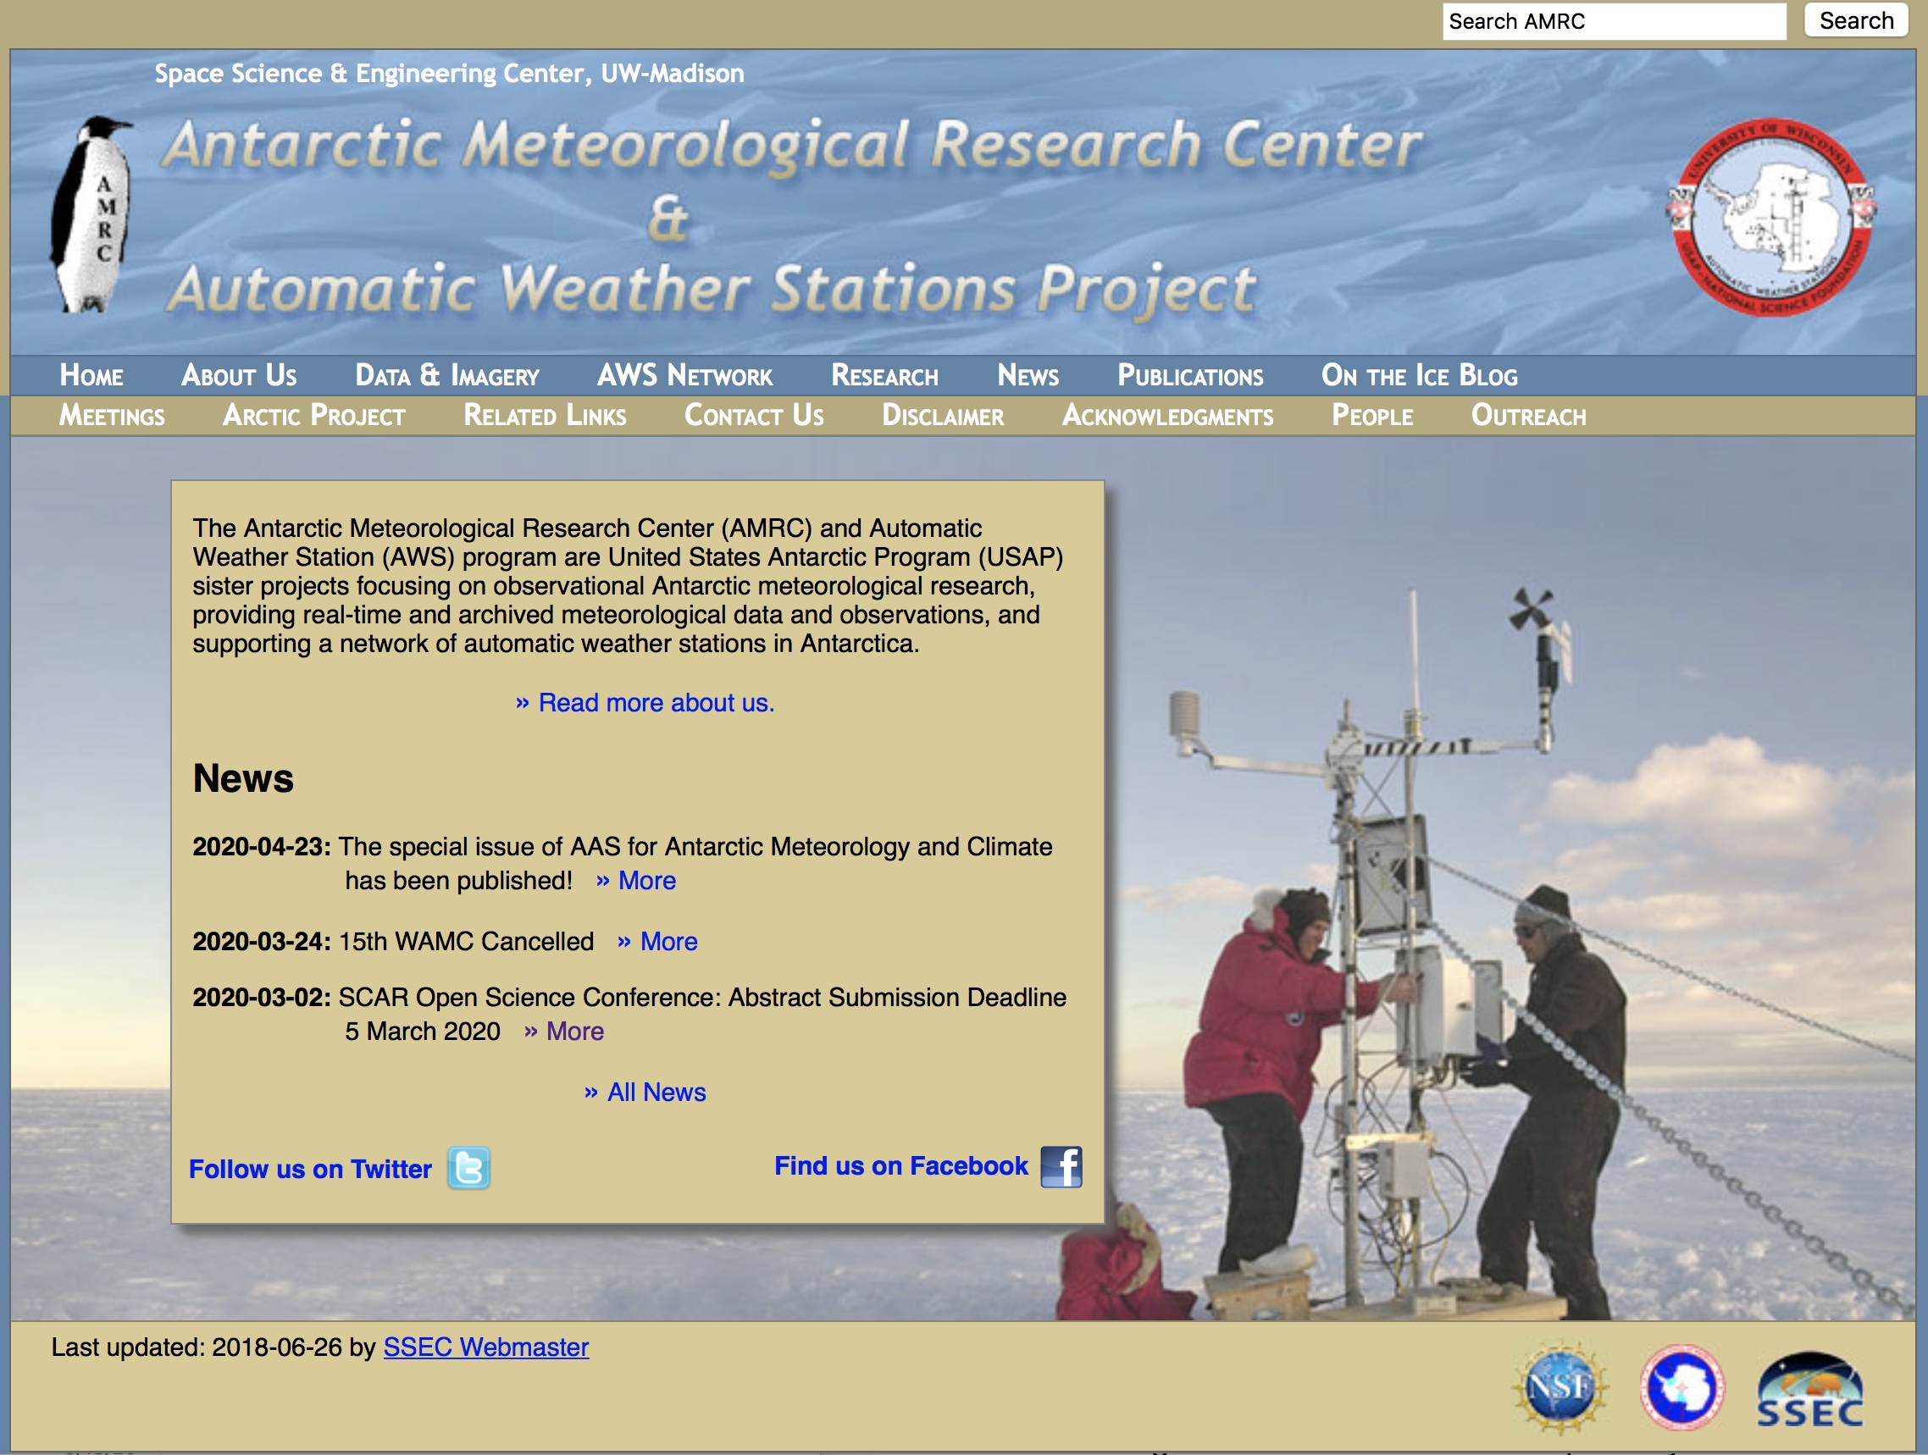
Website
Time for a new website!
Replace this older site
Face of the project to the world!
Offers EASY access to the data and information
ADA Compliant (also known as 508 Compliance, Section 508 and Section 504)

Slide 11
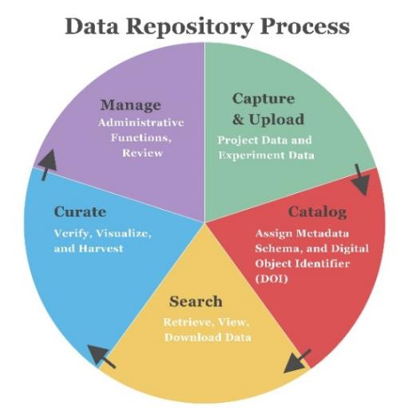
Data Repository and Archive System
Antarctic Meteorological Data Archive
Metadata
Digital Object Identifiers
Integrated into the website

Slide 12
Campaign Antarctic Meteorological Datasets
Enable the archive to take in other investigator’s datasets
  Meteorological Focus
Examples:
  Project FROST (First Regional Observing Study of the Troposphere)
  Year of Polar Projection – Southern Hemisphere (YOPP-SH)
Provide data curation, archive, host metadata, and assign digital object identifiers

Slide 13
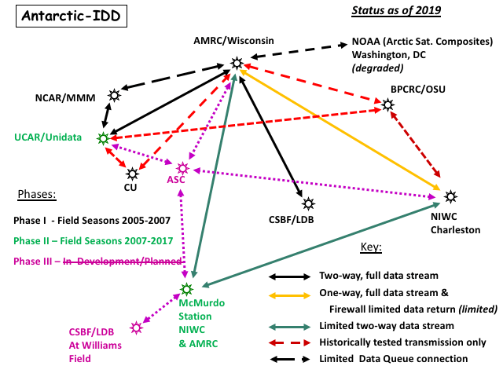
Meteorological Data Servers and Services
Providing real-time and archive data to & for the meteorological community:
Servers:
  McIDAS ADDE
  THREDDS
Services:
  Antarctic-IDD - LDM

Slide 14
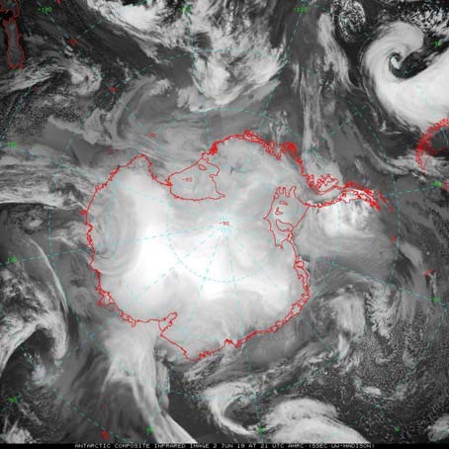
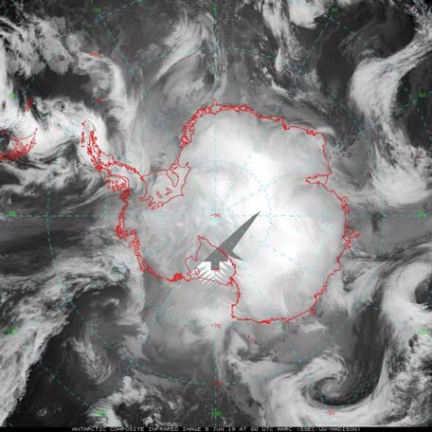
Antarctic Satellite Composite Imagery
This project begins *formal* operational support for these composites after 28 years of generation!!
Improve by including more satellites into the composite
Providing a “standard grid-north-up” product
Continue to make hourly composites available in 5 spectral channels.
(Operationally offer them to NOAA Ocean Prediction Center ??)

Slide 15
Case Studies, Climatological Reports & White Papers
“…Establish a center for authoritative evaluation of atmospheric and climate variations of Antarctica…”
Case Studies
  Study of significant weathers on an event by event basis
Climatological Reports
  Compliment existing reports (e.g. State of the Climate, etc.)
White Papers
  TBD
  As called for…

Slide 16
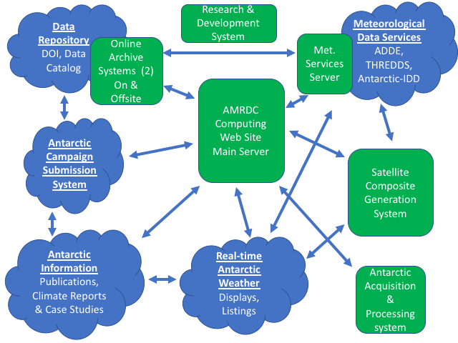
AMRDC
Computing
Servers:
7 Dell Linux Server systems
Laptops:
5 Mac Laptops

Slide 17
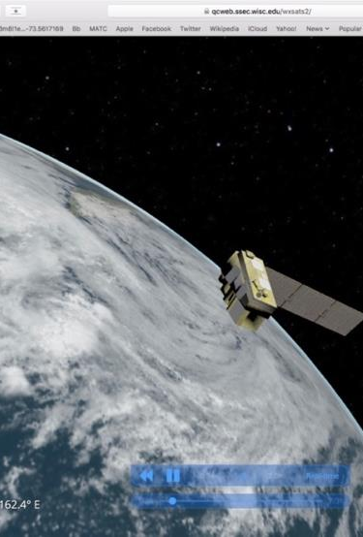
Personnel
Madison College
  Matthew Lazzara, PI
    Full-time staff member – Data expert (to be hired)
    Undergraduate students (to be hired)
  Jeff Havens, coPI
    Undergraduate students (to be hired)
UW-Madison
  Lee Welhouse
    Taylor Norton, Graduate student
  Jean Philips
    Graduate student (?)
  Jerry Robaidek
    Clayton Suplinski (Outreach/Broader Impact/WXSAT VR work)

Slide 18
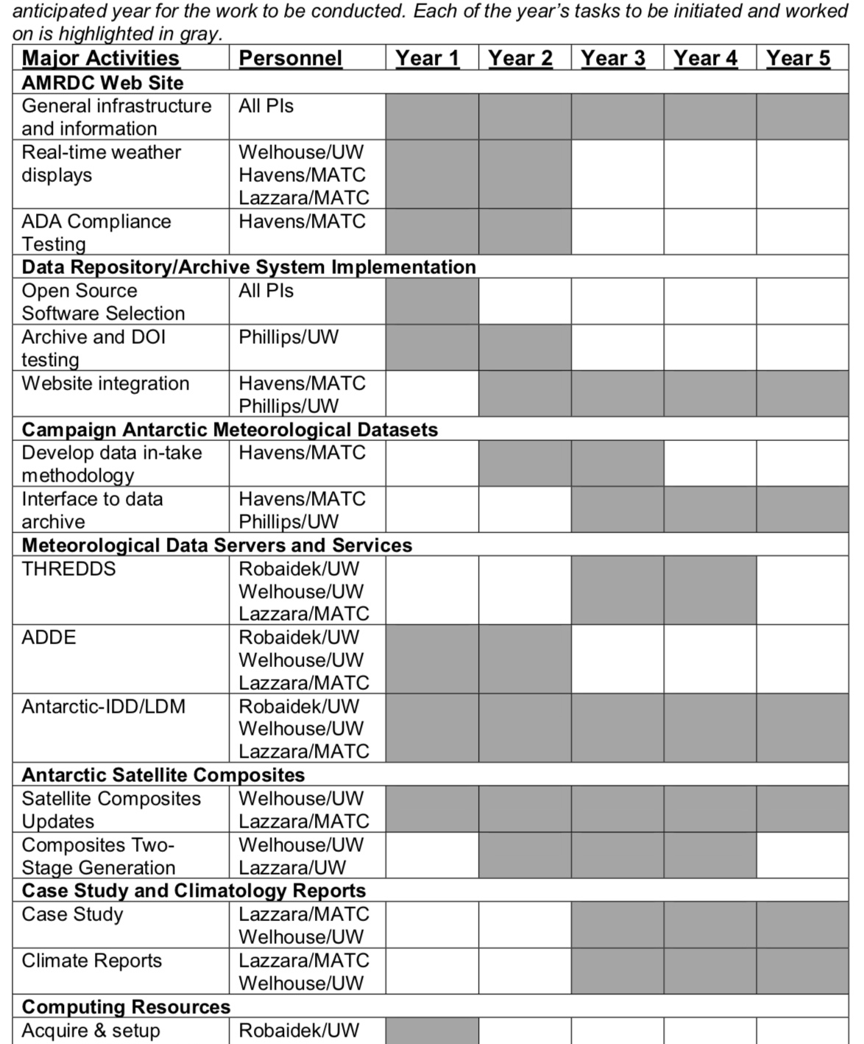
Timelines

Slide 19
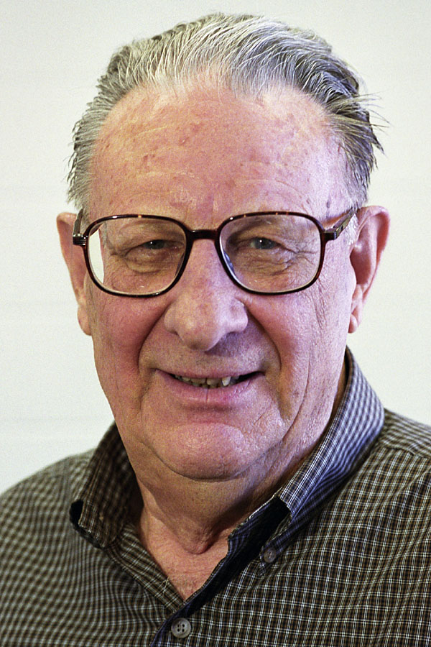
Summary…
The AMRDC aims to….
  Bring the best of AMRC into the 21st Century
  Establish the AMRDC as an official data center and repository
  Embrace community needs
  Include students in all aspects
  Convene an advisory board
  Operationalize the Antarctic-IDD and Antarctic Satellite composites
  Stand ready to serve the community as able.
…begin to bring Dr. Stearns’ dream to life!

Slide 20
Thank you!
Thank you to this community and NSF Grants #1951603 and #1951720
Questions?
mlazzara@madisoncollege.edu

